Slide 1
Functions and an Introduction to Recursion
Chapter 6 of C++ How to Program, 9/e
©1992-2017 by Pearson Education, Inc. All Rights Reserved.

Slide 2
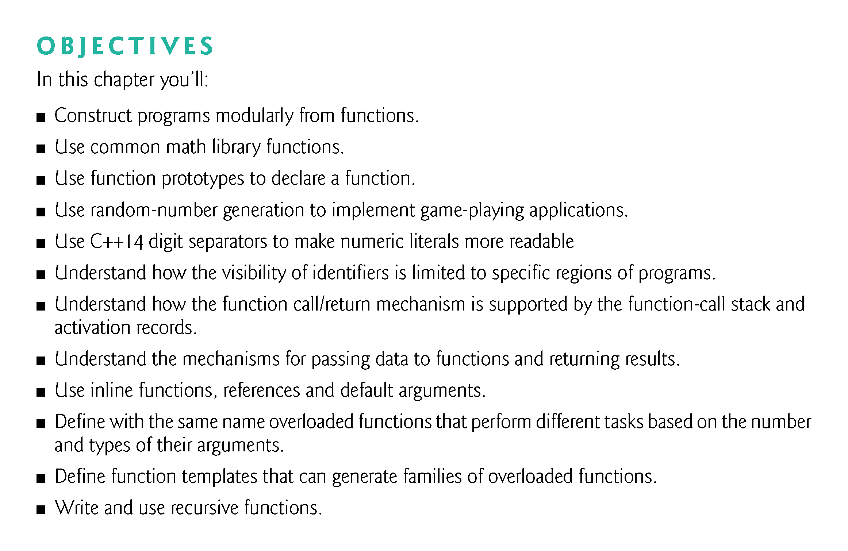
©1992-2017 by Pearson Education, Inc. All Rights Reserved.

Slide 3
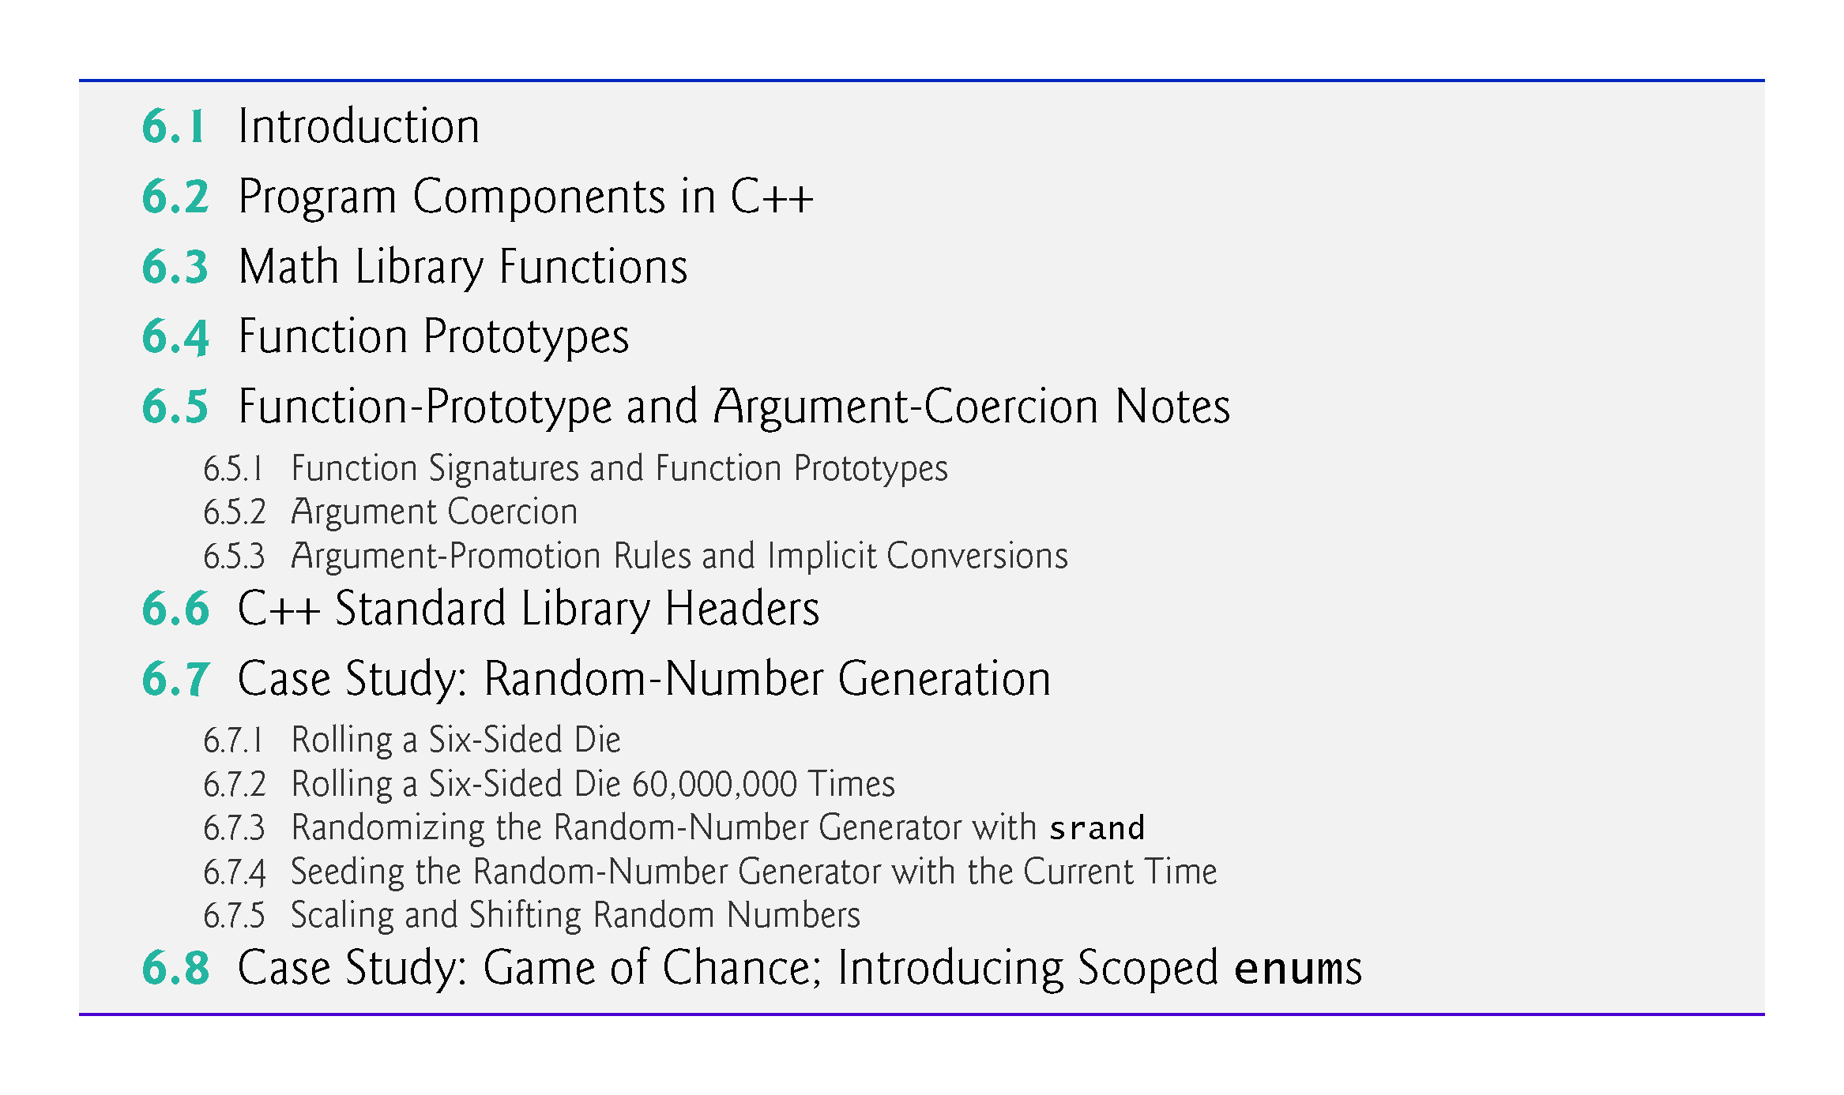
©1992-2017 by Pearson Education, Inc. All Rights Reserved.

Slide 4
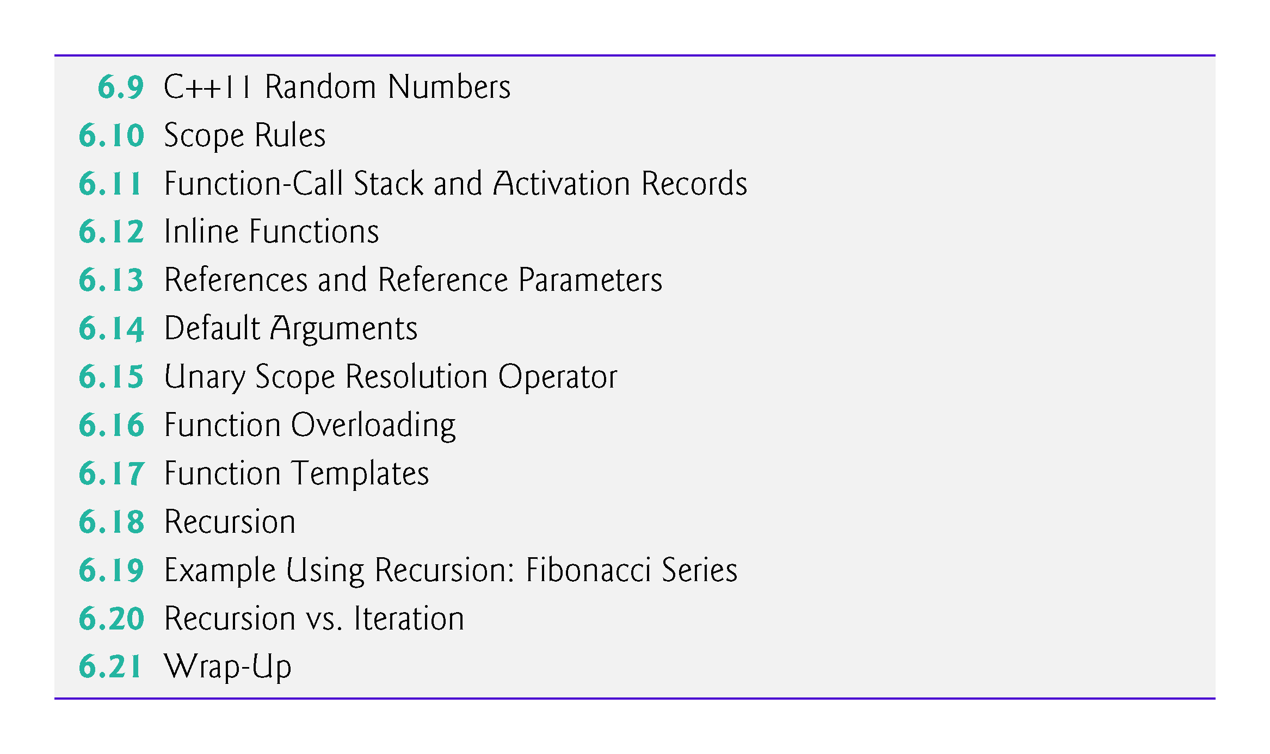
©1992-2017 by Pearson Education, Inc. All Rights Reserved.

Slide 5
6.6 C++ Standard Library Header Files
The C++ Standard Library is divided into many portions, each with its own header file.
The header files contain the function prototypes for the related functions that form each portion of the library.
The header files also contain definitions of various class types and functions, as well as constants needed by those functions.
A header file “instructs” the compiler on how to interface with library and user-written components.
Figure 6.5 lists some common C++ Standard Library header files, most of which are discussed later in the book.
©1992-2017 by Pearson Education, Inc. All Rights Reserved.

Slide 6
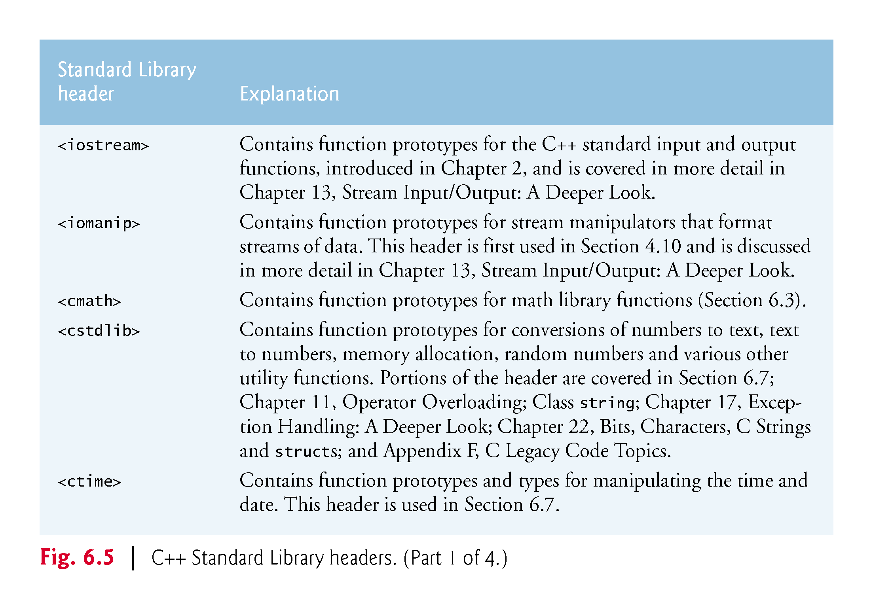
©1992-2017 by Pearson Education, Inc. All Rights Reserved.

Slide 7
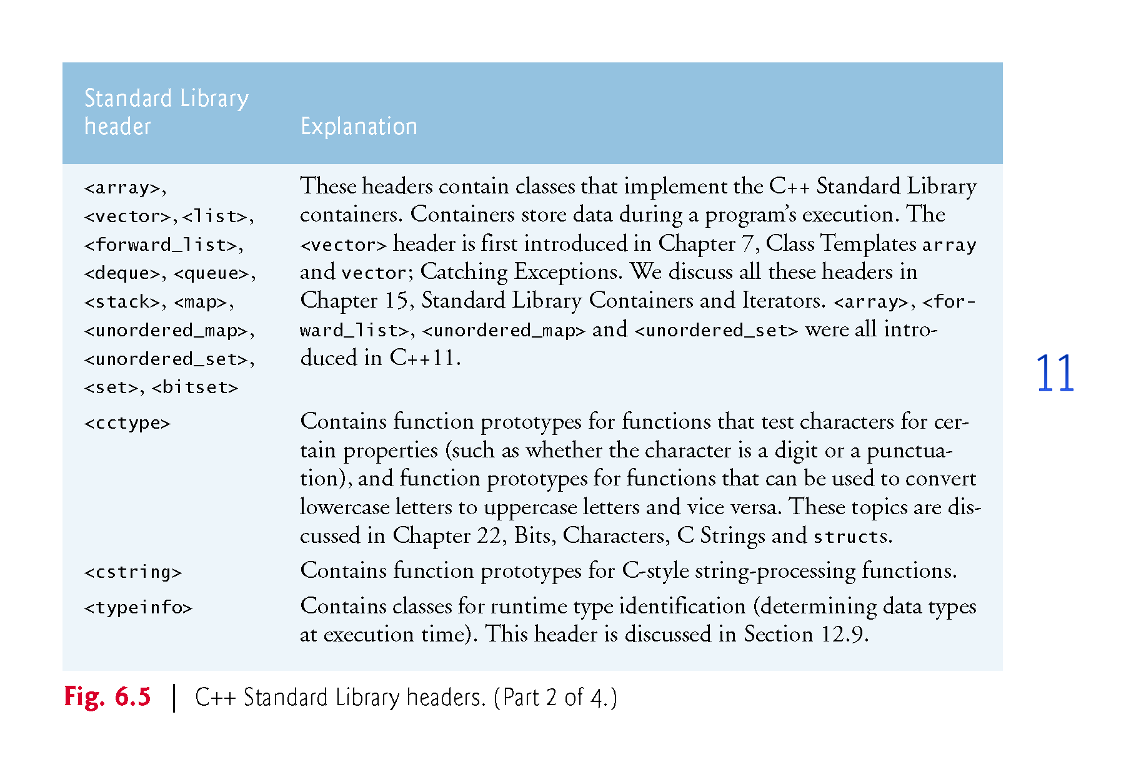
©1992-2017 by Pearson Education, Inc. All Rights Reserved.

Slide 8
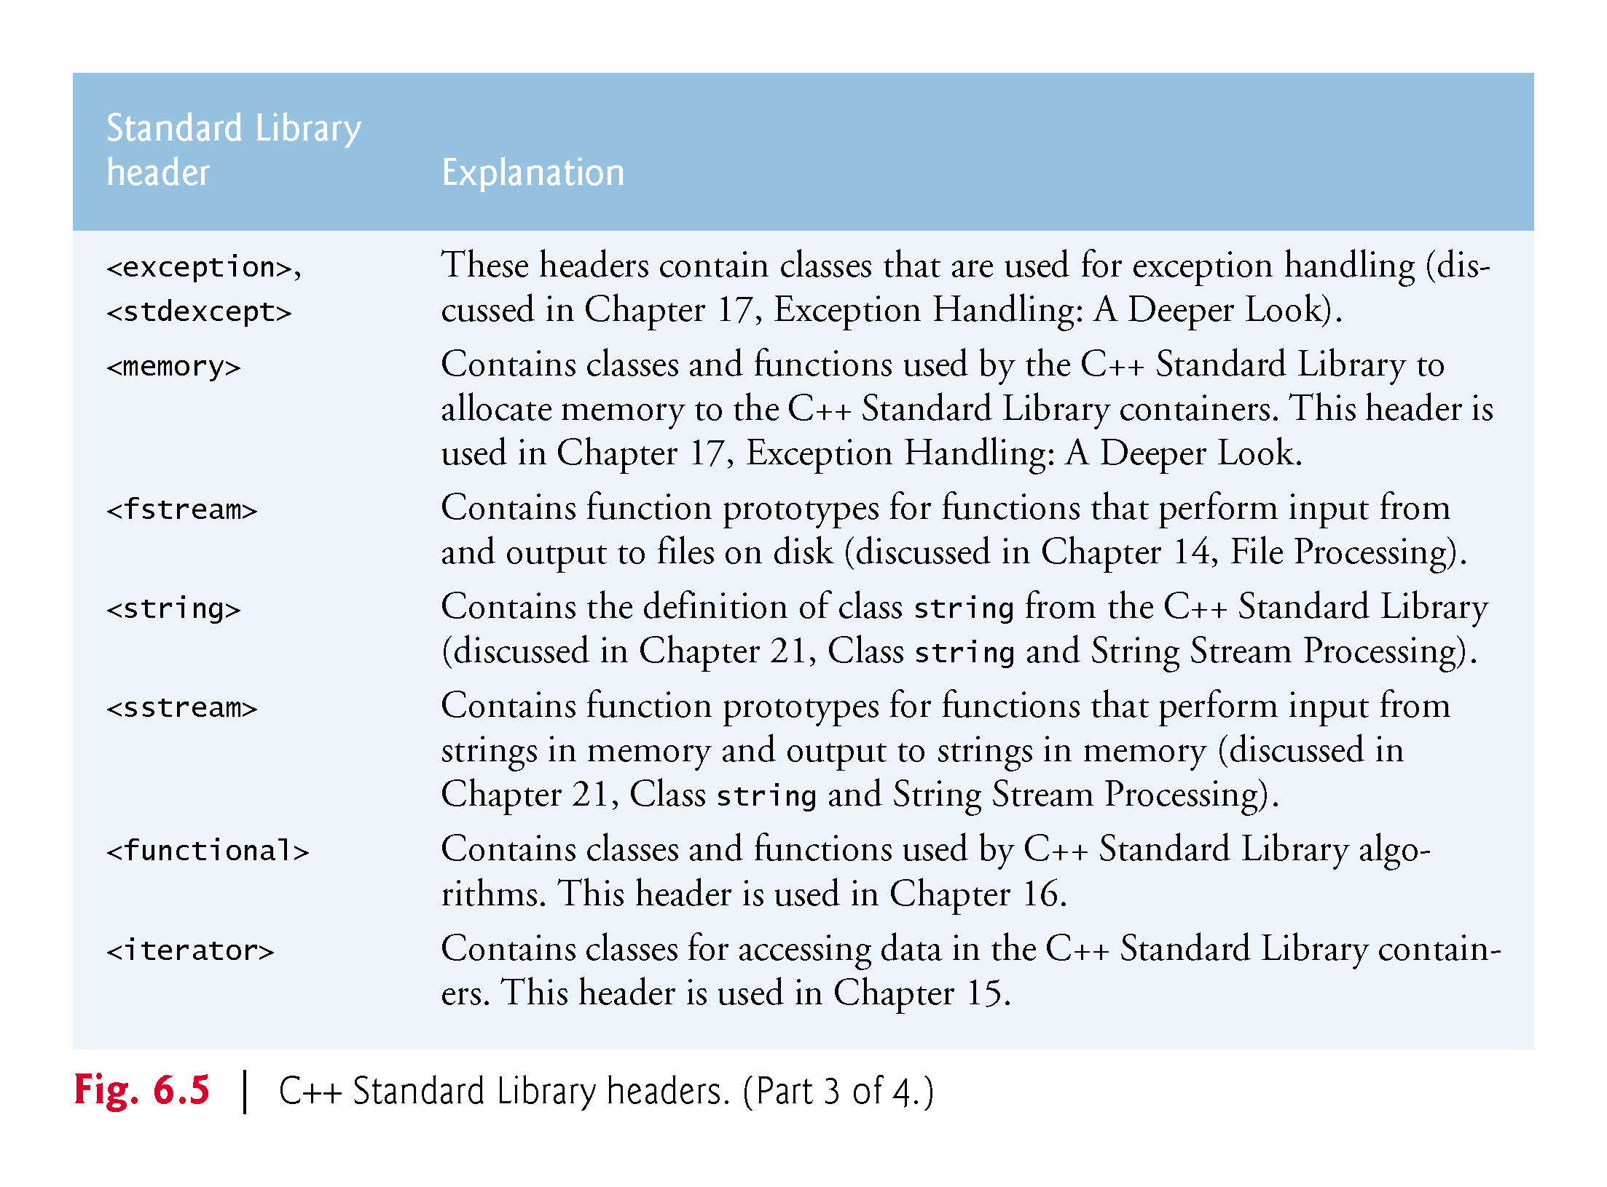
©1992-2017 by Pearson Education, Inc. All Rights Reserved.

Slide 9
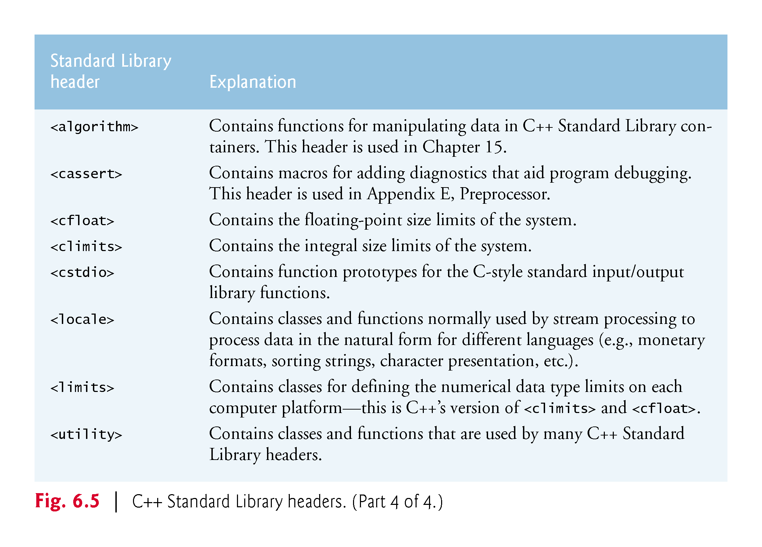
©1992-2017 by Pearson Education, Inc. All Rights Reserved.

Slide 10
6.6.5 Variables – scope and lifetime
When an identifier (that is, a variable, such as “int i”) is declared, it has two important characteristics:
Where is the variable usable (scope).
How long is the variable usable (lifetime).
Click here for a good explanation of these concepts:
http://www.mathcs.emory.edu/~cheung/Courses/561/Syllabus/3-C/scoping.html
©1992-2017 by Pearson Education, Inc. All Rights Reserved.

Slide 11
6.6.5 Scope: 6 kinds
Block scope: A name declared within a function, including the parameter names, has local scope. They are only visible from their point of declaration to the end of the function. Any variable defined within a pair of braces { … } has block scope.
Global namespace scope: A global name is one that is declared outside of any class or function. The scope of global names extends from the point of declaration to the end of the file in which they are declared.
Class scope: Names of class members have class scope, which extends throughout the class definition regardless of the point of declaration.
Function scope Variables declared within a function have function scope, which means it is visible throughout a function body even before its point of declaration.
Function-prototype scope: Names used in a function prototype are visible until the end of the prototype declaration.
Namespace scope: A name that is declared within a namespace, outside of any class or enum definition or function block, is visible from its point of declaration to the end of namespace.
©1992-2017 by Pearson Education, Inc. All Rights Reserved.

Slide 12
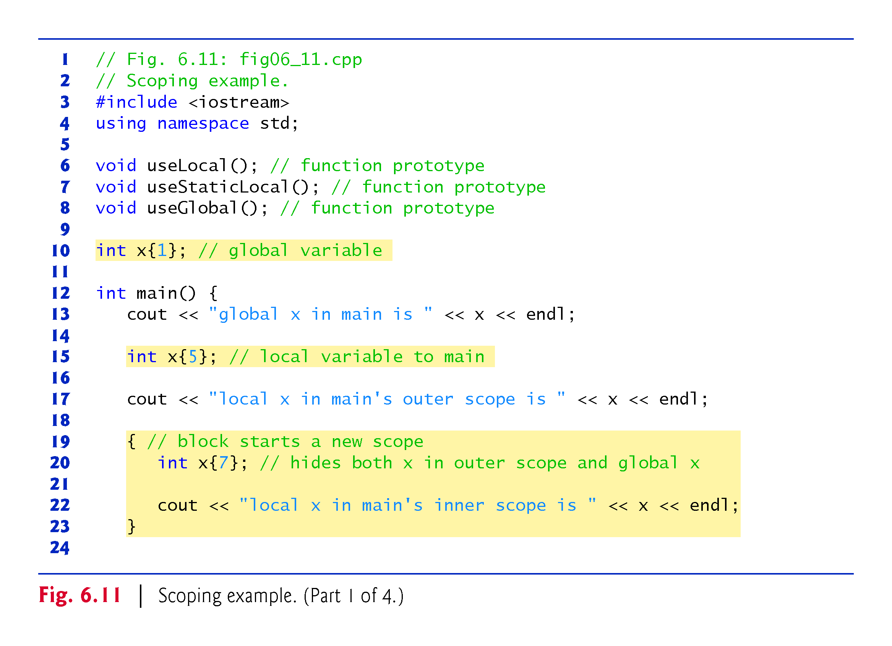
©1992-2017 by Pearson Education, Inc. All Rights Reserved.

Slide 13
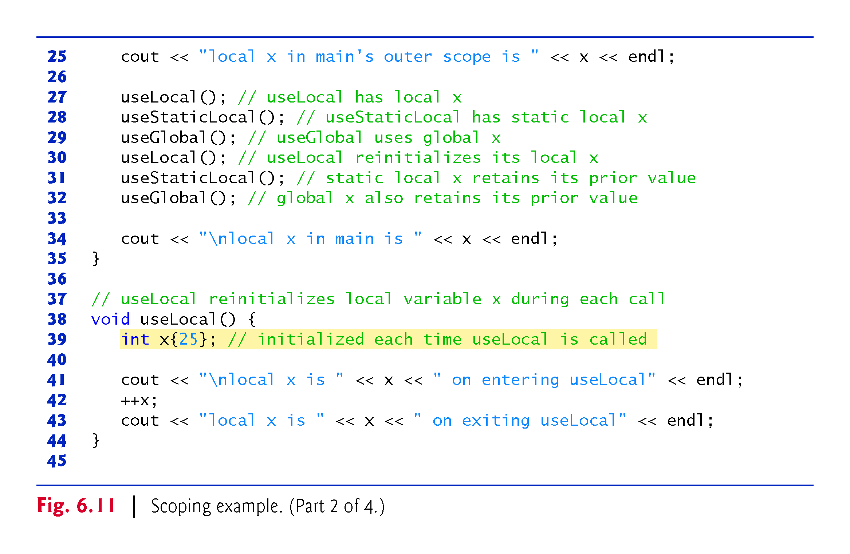
©1992-2017 by Pearson Education, Inc. All Rights Reserved.

Slide 14
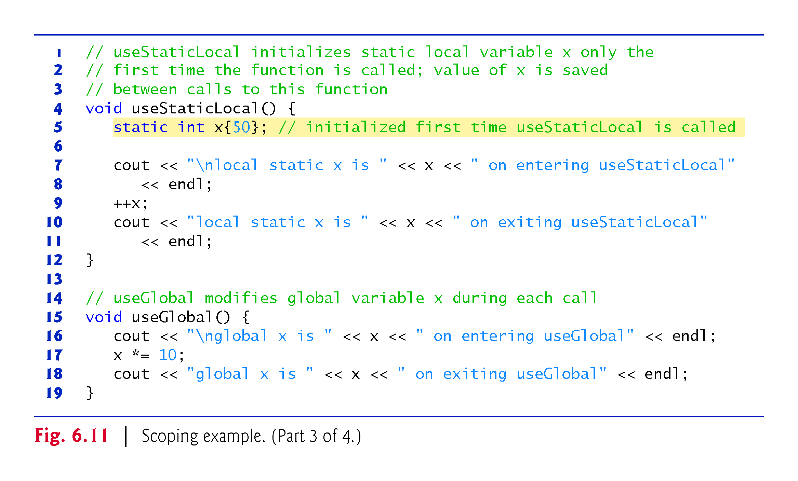
©1992-2017 by Pearson Education, Inc. All Rights Reserved.

Slide 15
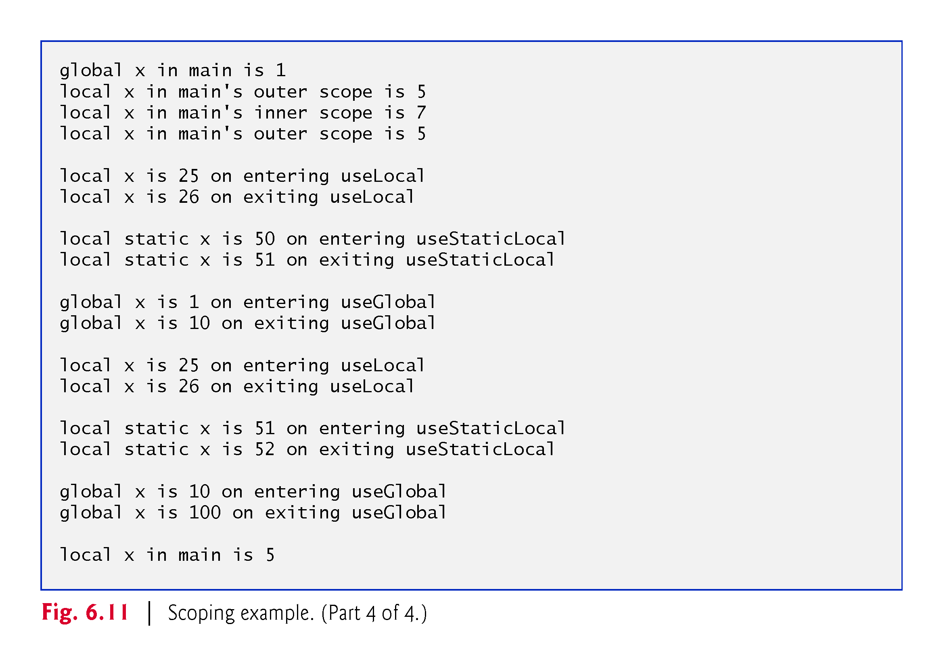
©1992-2017 by Pearson Education, Inc. All Rights Reserved.

Slide 16
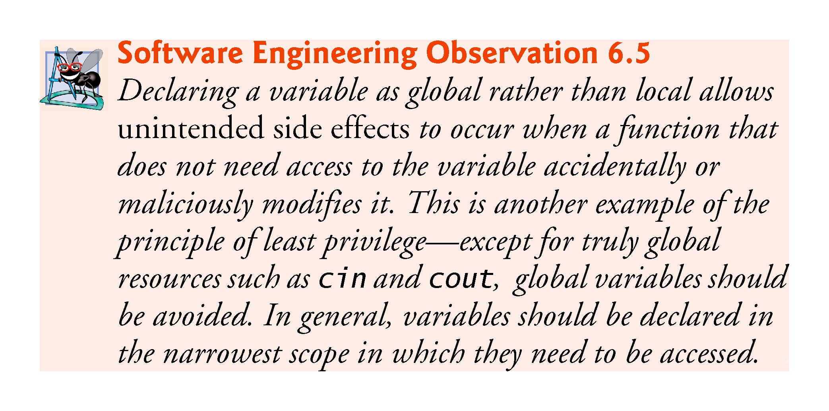
©1992-2017 by Pearson Education, Inc. All Rights Reserved.

Slide 17
6.6.5 Lifetime (aka storage class): 5 kinds
Every variable in C++ exists, has a constant address, and retains its last-stored value (except when the value is indeterminate) over a portion of program execution known as this object's lifetime. Variables are destroyed (that is, forgotten for ever) as soon as the program feels that they are not needed.
Auto: The default when no storage class is specified. They stay in memory only until the last brace where it is defined is executed, then it dies.
Register: Same as auto, but its value is placed in CPU registers for faster access.
Static: They live from the point when they are defined until the program ends. NOTE that they may have local scope (so cannot be seen from outside) but their value is preserved until the end.
Extern: Same as static, except that in addition they have global scope even across different files. Do not worry about this at this point!
Mutable: This is only used with classes, which we will see soon. Mutable is used for data members in a class to make them modifiable even when the class is declared constant. Do not worry about this at this point!
©1992-2017 by Pearson Education, Inc. All Rights Reserved.

Slide 18
6.6.7 The const qualifier - identifiers
Programs often have constant identifiers (constant variables sounds funny). For example, if I have to write many functions involving the number 3.14159265359, it is easier to define “double PI= 3.14159265359;” and then use PI instead of having to write that long number. The problem is that by accident PI could be modified. To prevent this C++ has the constant qualifier that impedes functions to modify the value:
const int PI = 3.14159265359;
If you then write something like PI = 3.14, you will get an error. This is good to catch mistakes.
©1992-2017 by Pearson Education, Inc. All Rights Reserved.

Slide 19
6.7 Case Study: Random Number Generation
The element of chance can be introduced into computer applications by using the C++ Standard Library function rand.
The function rand generates an unsigned integer between 0 and RAND_MAX (a symbolic constant defined in the <cstdlib> header file).
For GNU C++, the value of RAND_MAX is 2147483647; for Visual Studio, the value of RAND_MAX is 32767.
If rand truly produces integers at random, every number between 0 and RAND_MAX has an equal chance (or probability) of being chosen each time rand is called.
To find the value of RAND_MAX, write a program with #include <cstdlib> and type cout << RAND_MAX << endl;
©1992-2017 by Pearson Education, Inc. All Rights Reserved.

Slide 20
6.7.1 Rolling a Six-Sided Die
The function prototype for the rand function is in <cstdlib>.
To produce integers in the range 0 to 5, we use the modulus operator (%) with rand:
rand() % 6
This is called scaling.
The number 6 is called the scaling factor. Six values are produced.
We can shift the range of numbers produced by adding a value.
©1992-2017 by Pearson Education, Inc. All Rights Reserved.

Slide 21
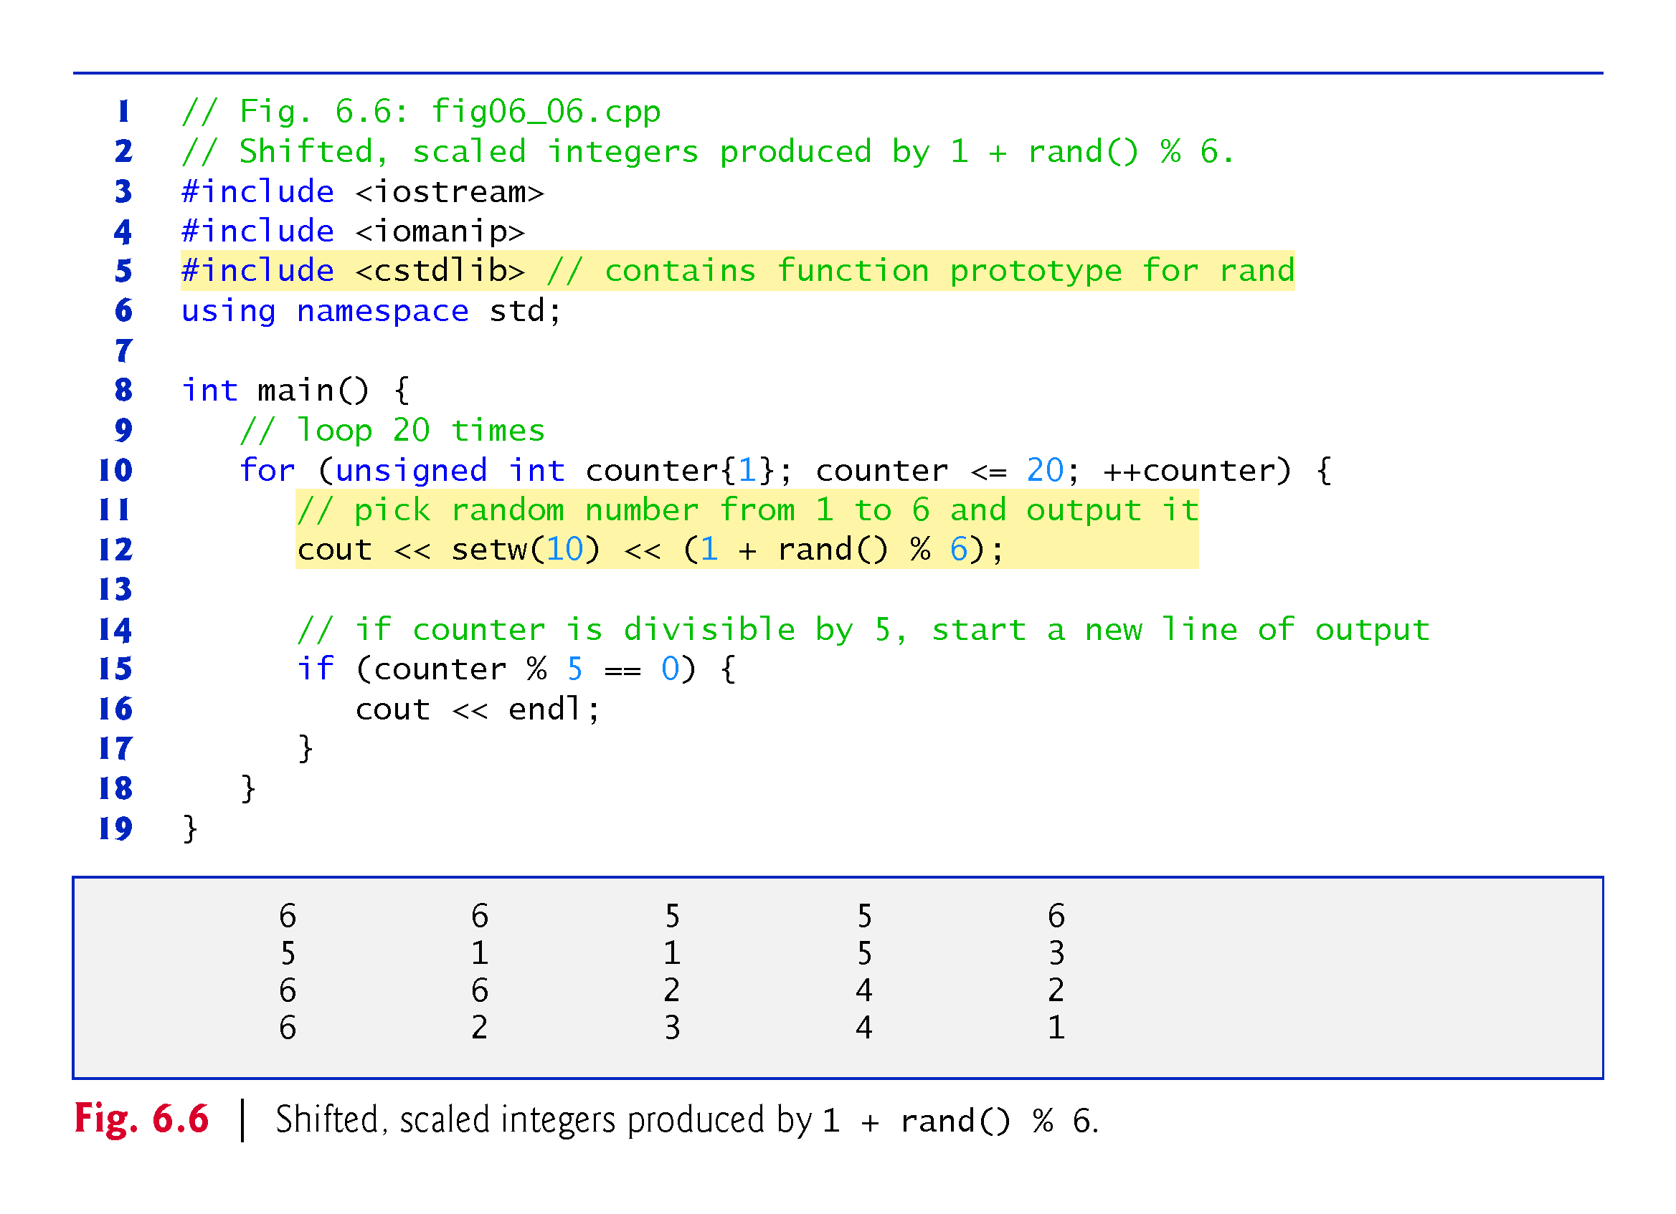
©1992-2017 by Pearson Education, Inc. All Rights Reserved.

Slide 22
6.7.2 Rolling a Six-Sided Die 60,000,000 Times
To show that the numbers produced by rand occur with approximately equal likelihood, Fig. 6.7 simulates 60,000,000 rolls of a die.
Each integer in the range 1 to 6 should appear approximately 10,000,000 times.
©1992-2017 by Pearson Education, Inc. All Rights Reserved.

Slide 23
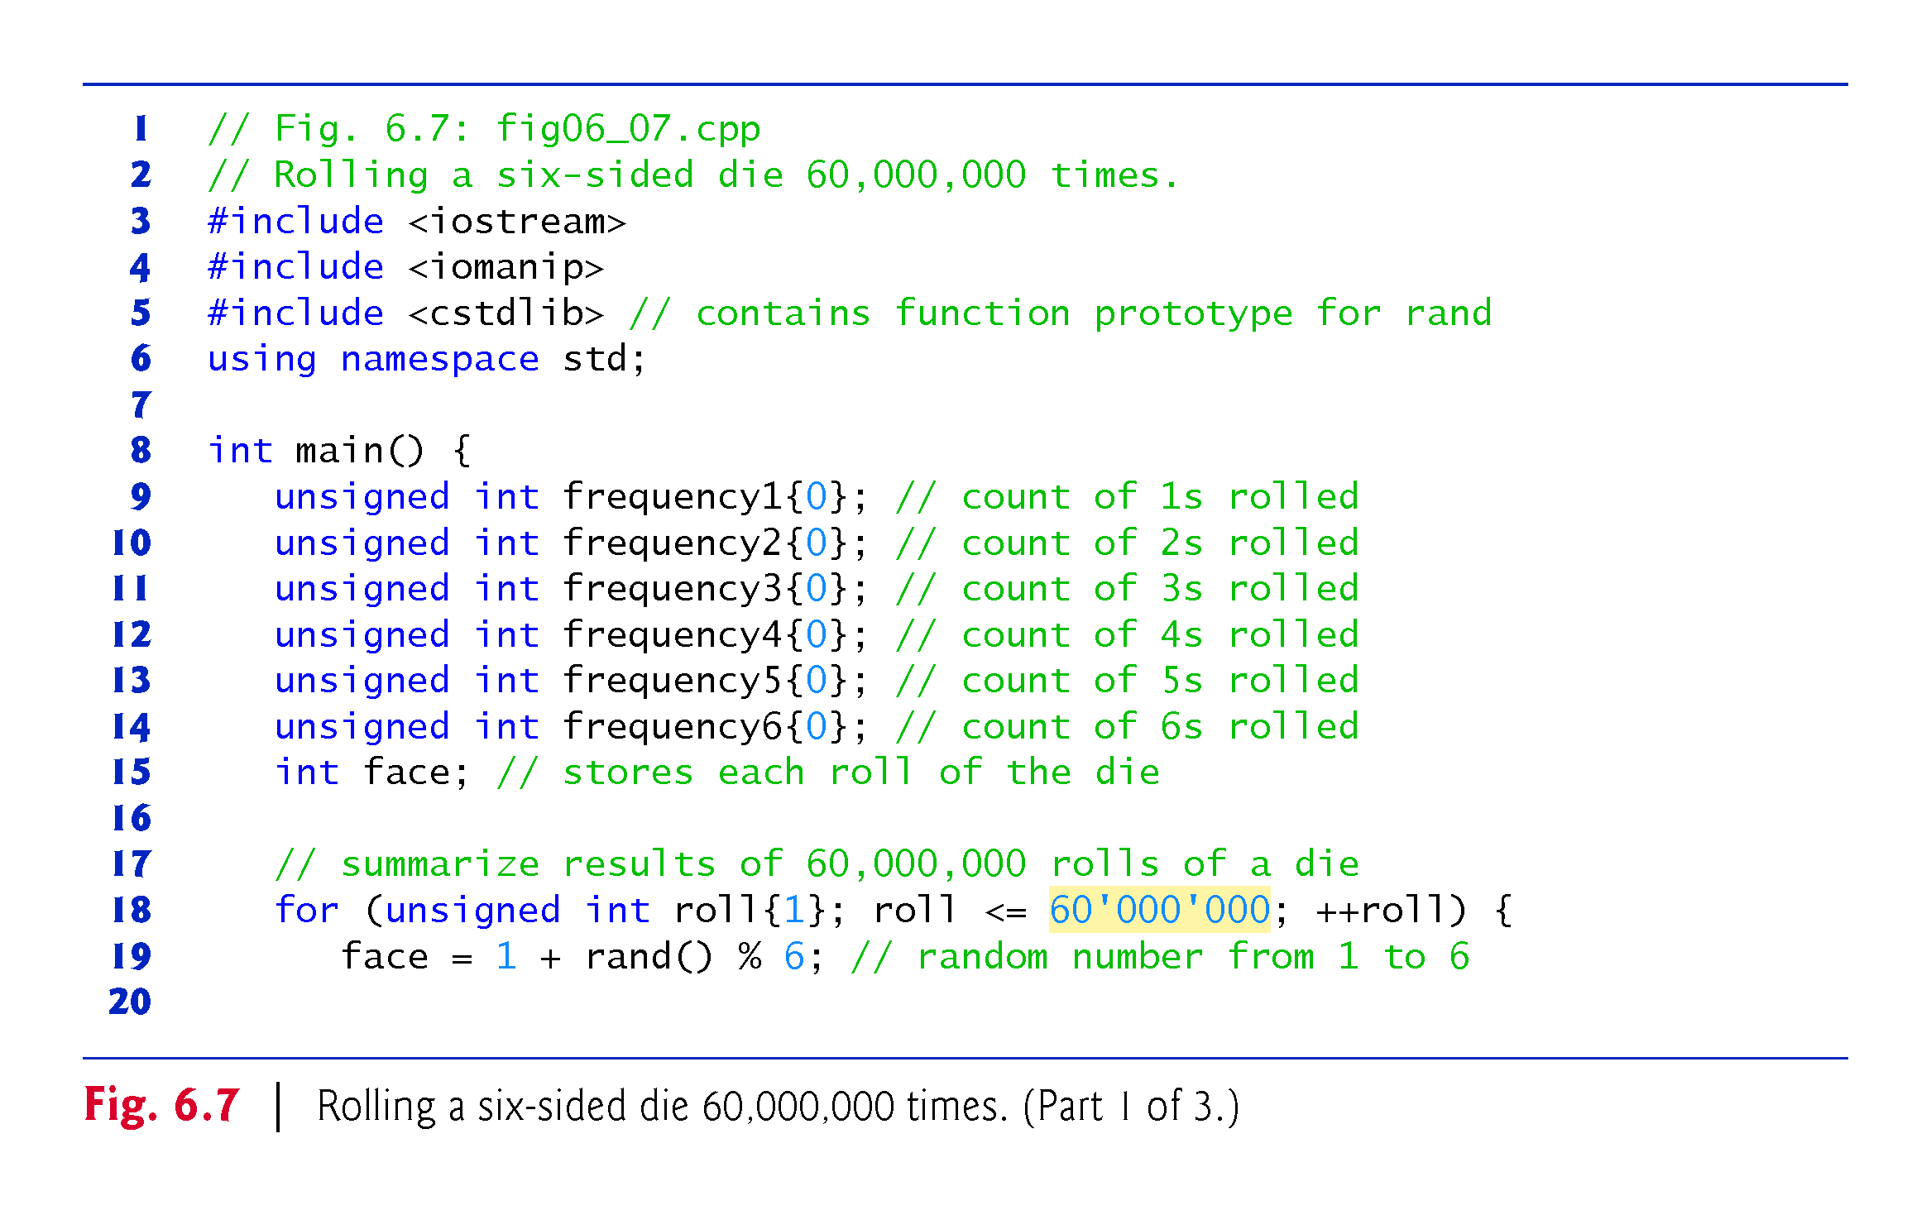
©1992-2017 by Pearson Education, Inc. All Rights Reserved.

Slide 24
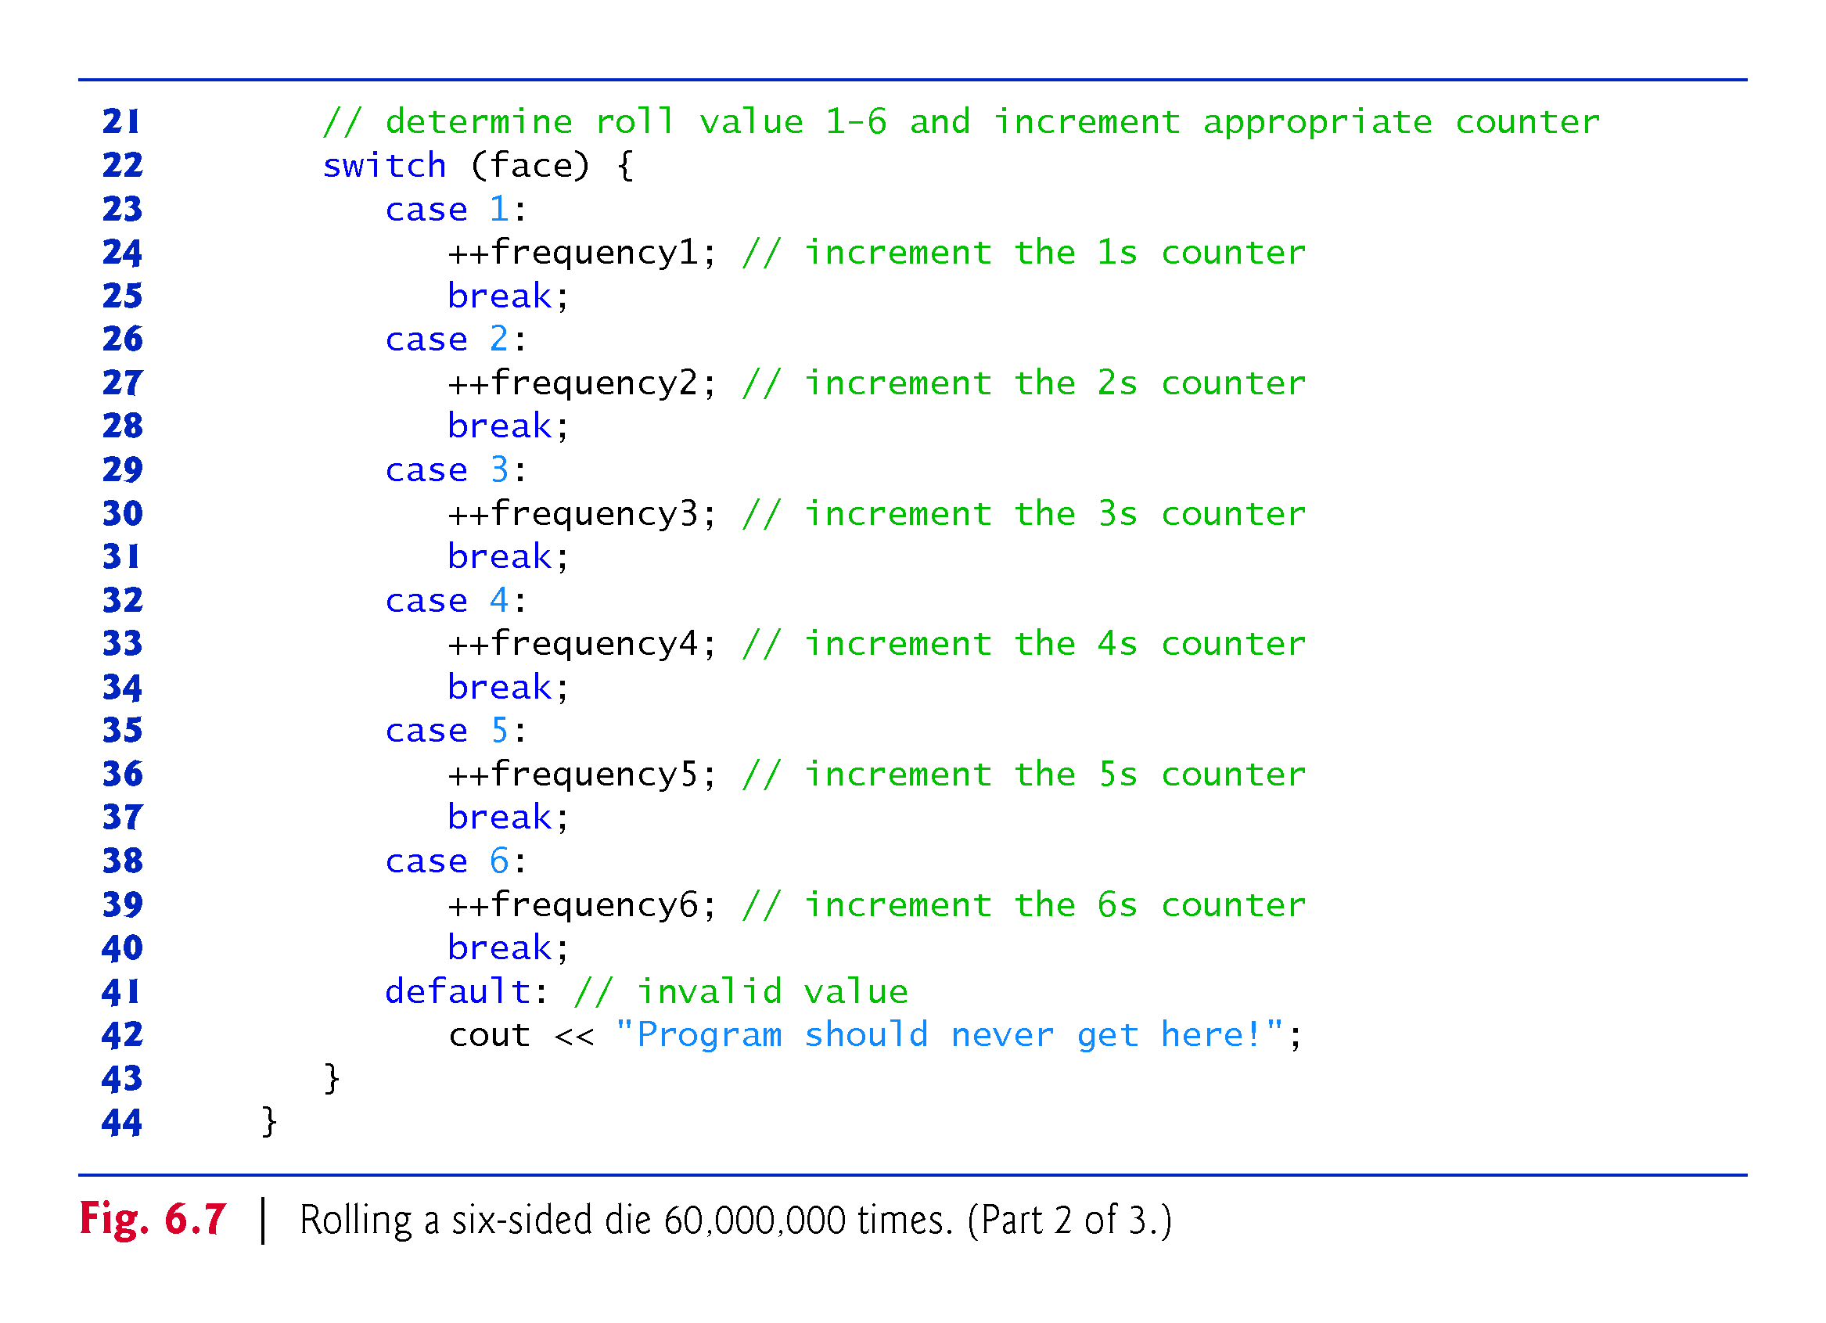
©1992-2017 by Pearson Education, Inc. All Rights Reserved.

Slide 25
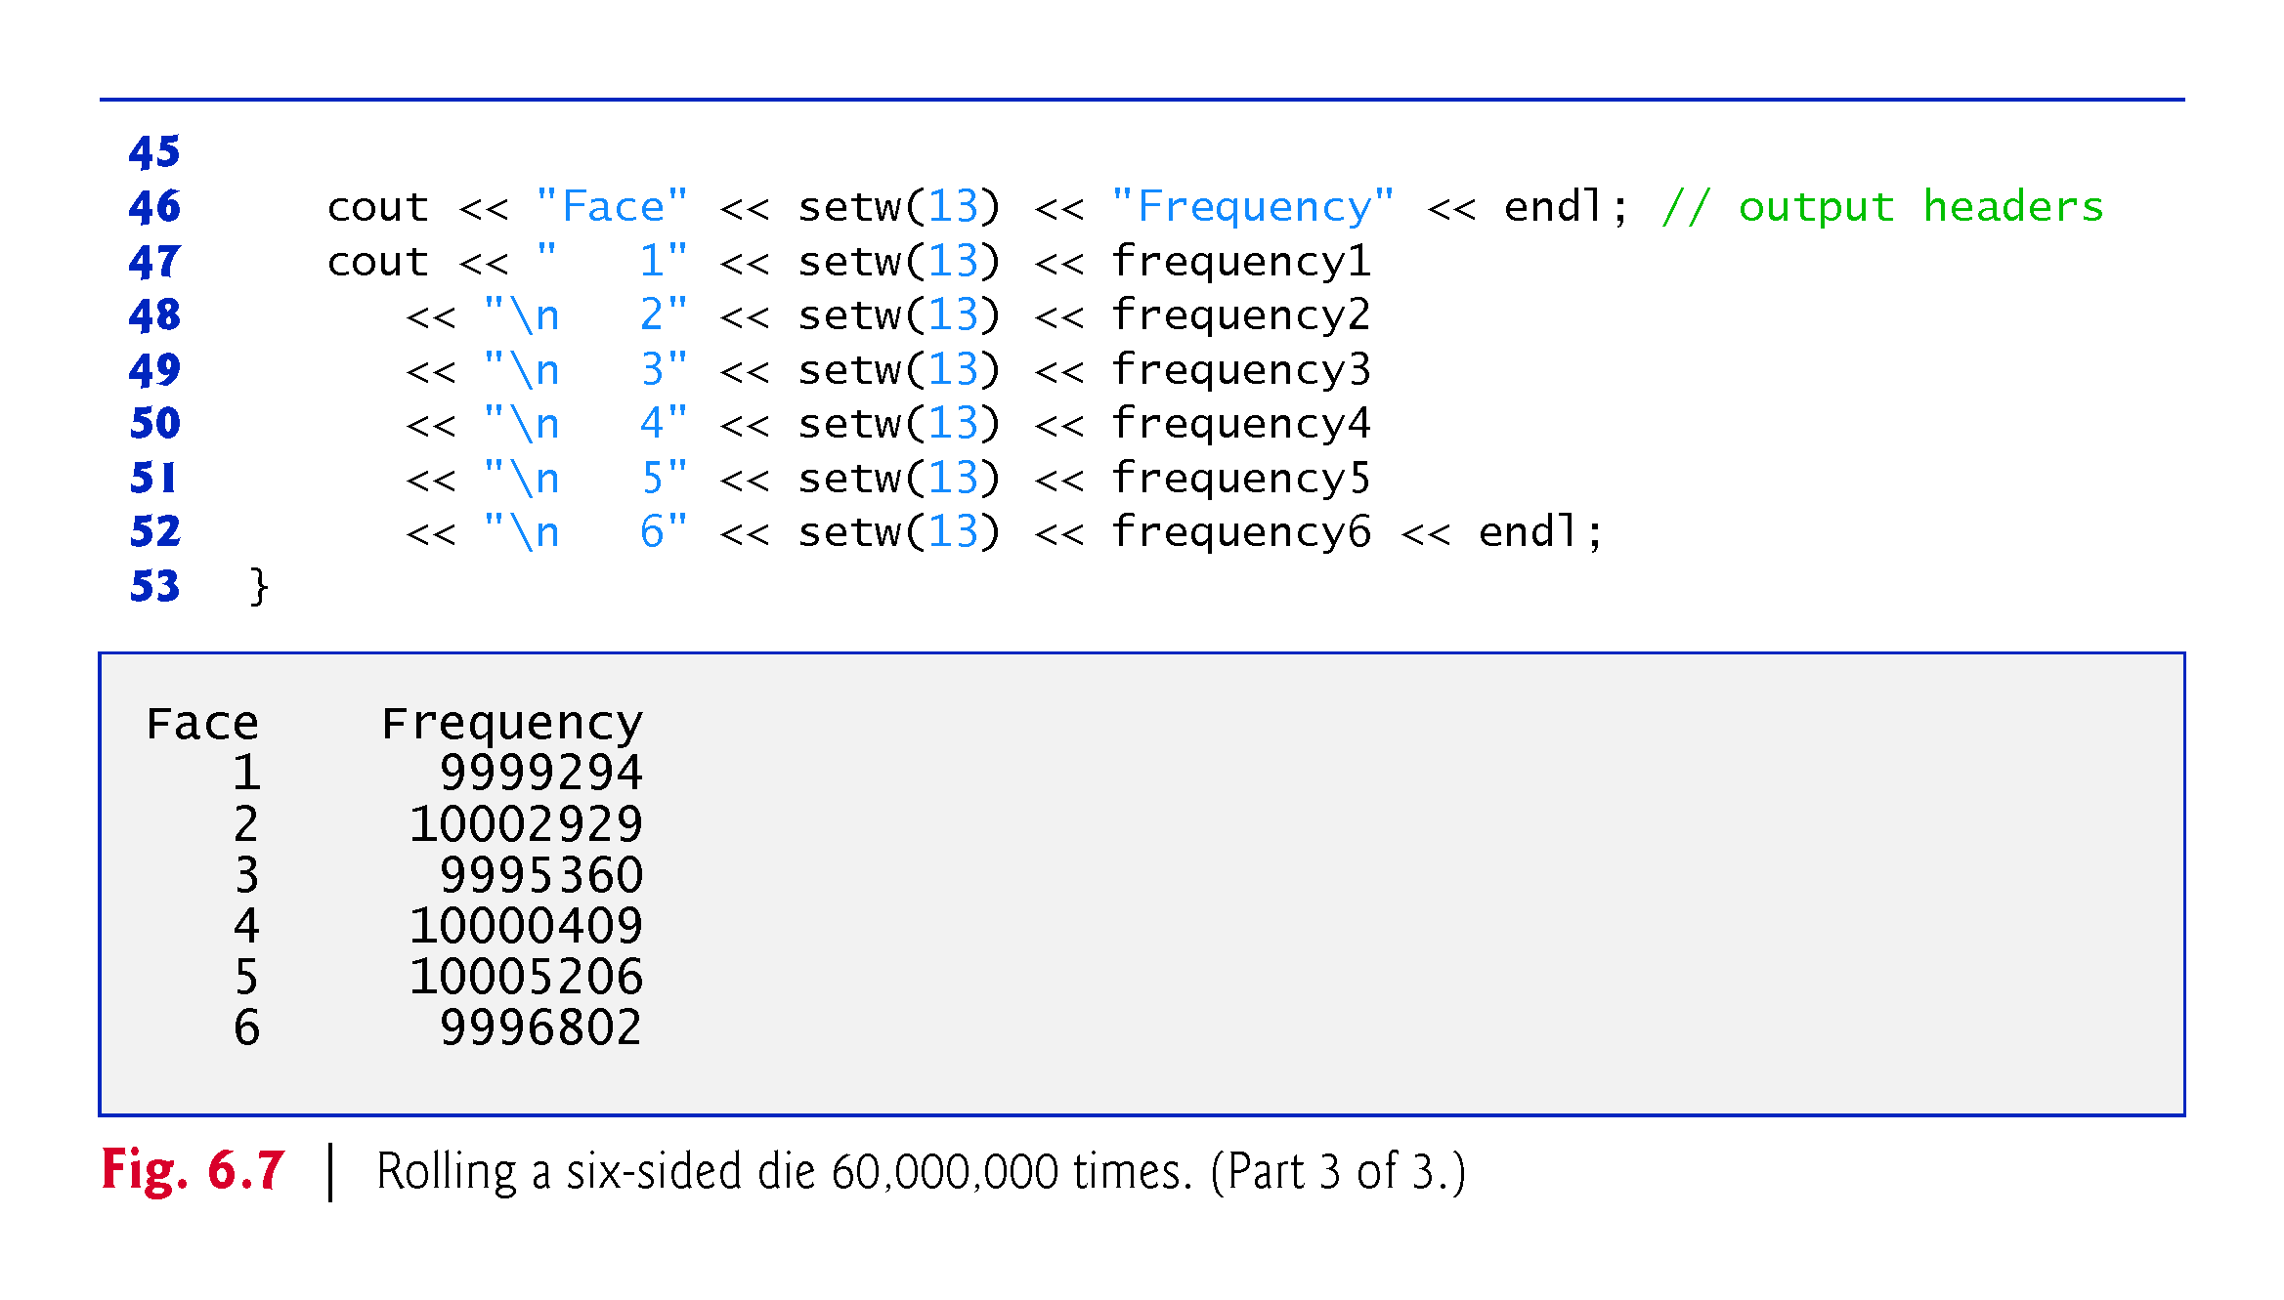
©1992-2017 by Pearson Education, Inc. All Rights Reserved.

Slide 26
6.7.3 Randomizing the Random-Number Generator with srand
Executing the program of Fig. 6.6 again produces exactly the same sequence of values.
Repeatability is an important characteristic of rand.
Can help with testing and debugging.
rand generates pseudorandom numbers.
a sequence of numbers that appears to be random.
sequence repeats itself each time the program executes.
©1992-2017 by Pearson Education, Inc. All Rights Reserved.

Slide 27
6.7.3 Randomizing the Random-Number Generator with srand
Once a program has been debugged, it can be conditioned to produce a different sequence of random numbers for each execution.
This is called randomizing and is accomplished with the C++ Standard Library function srand.
Takes an unsigned integer argument and seeds rand to produce a different sequence of random numbers for each execution.
©1992-2017 by Pearson Education, Inc. All Rights Reserved.

Slide 28
6.7 Case Study: Random Number Generation (cont.)
Seeding the Random Number Generator with srand
Figure 6.8 demonstrates function srand.
©1992-2017 by Pearson Education, Inc. All Rights Reserved.

Slide 29
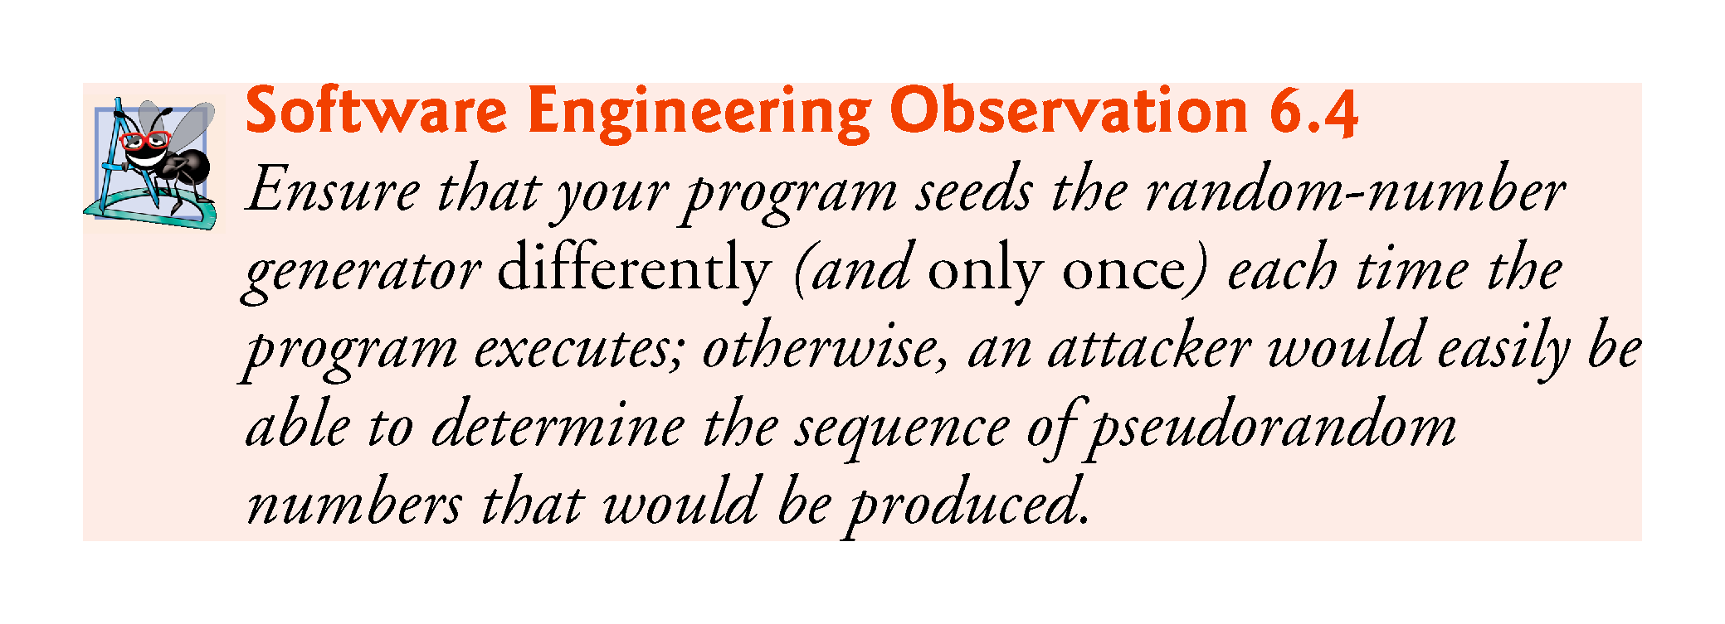
©1992-2017 by Pearson Education, Inc. All Rights Reserved.

Slide 30
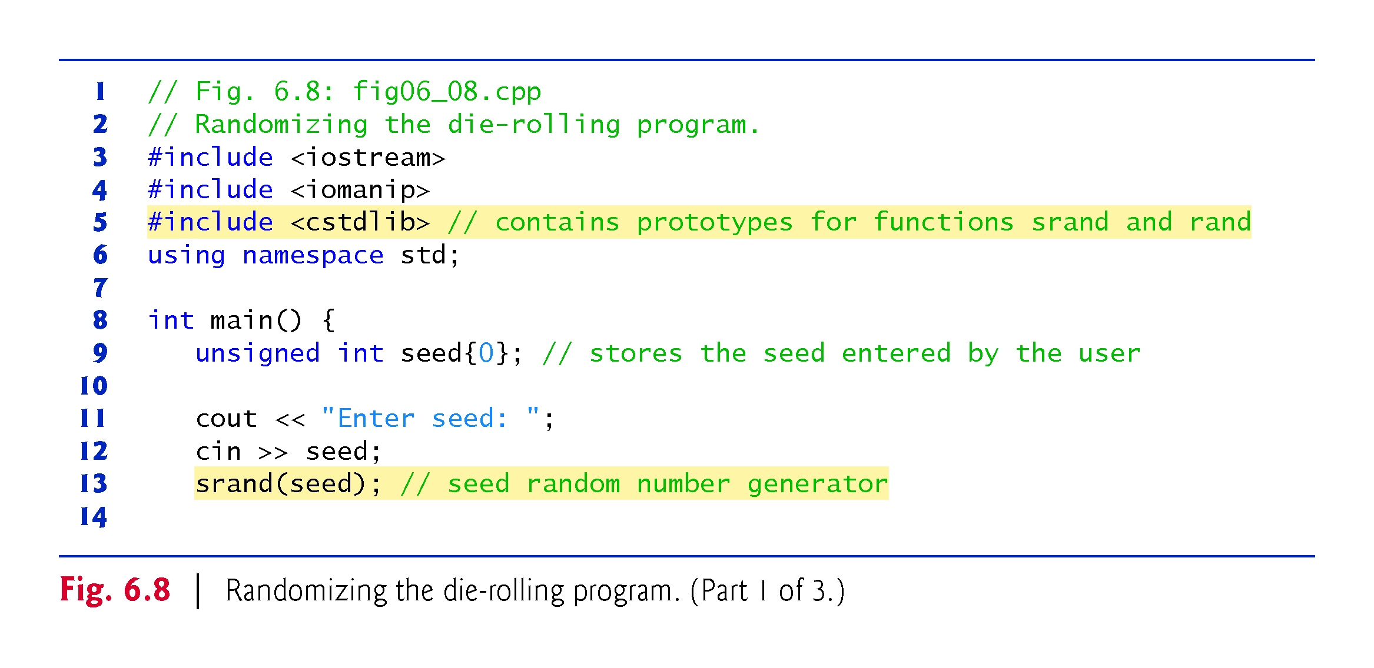
©1992-2017 by Pearson Education, Inc. All Rights Reserved.

Slide 31
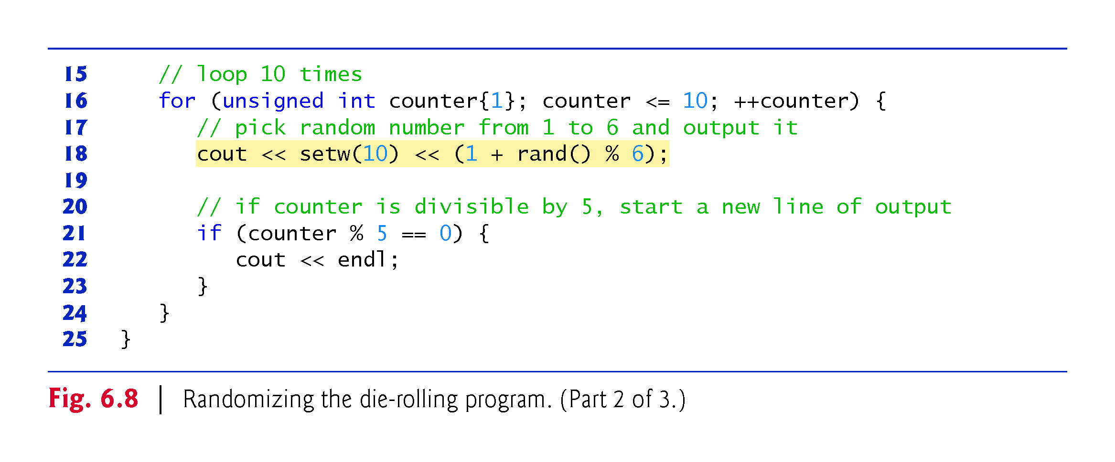
©1992-2017 by Pearson Education, Inc. All Rights Reserved.

Slide 32
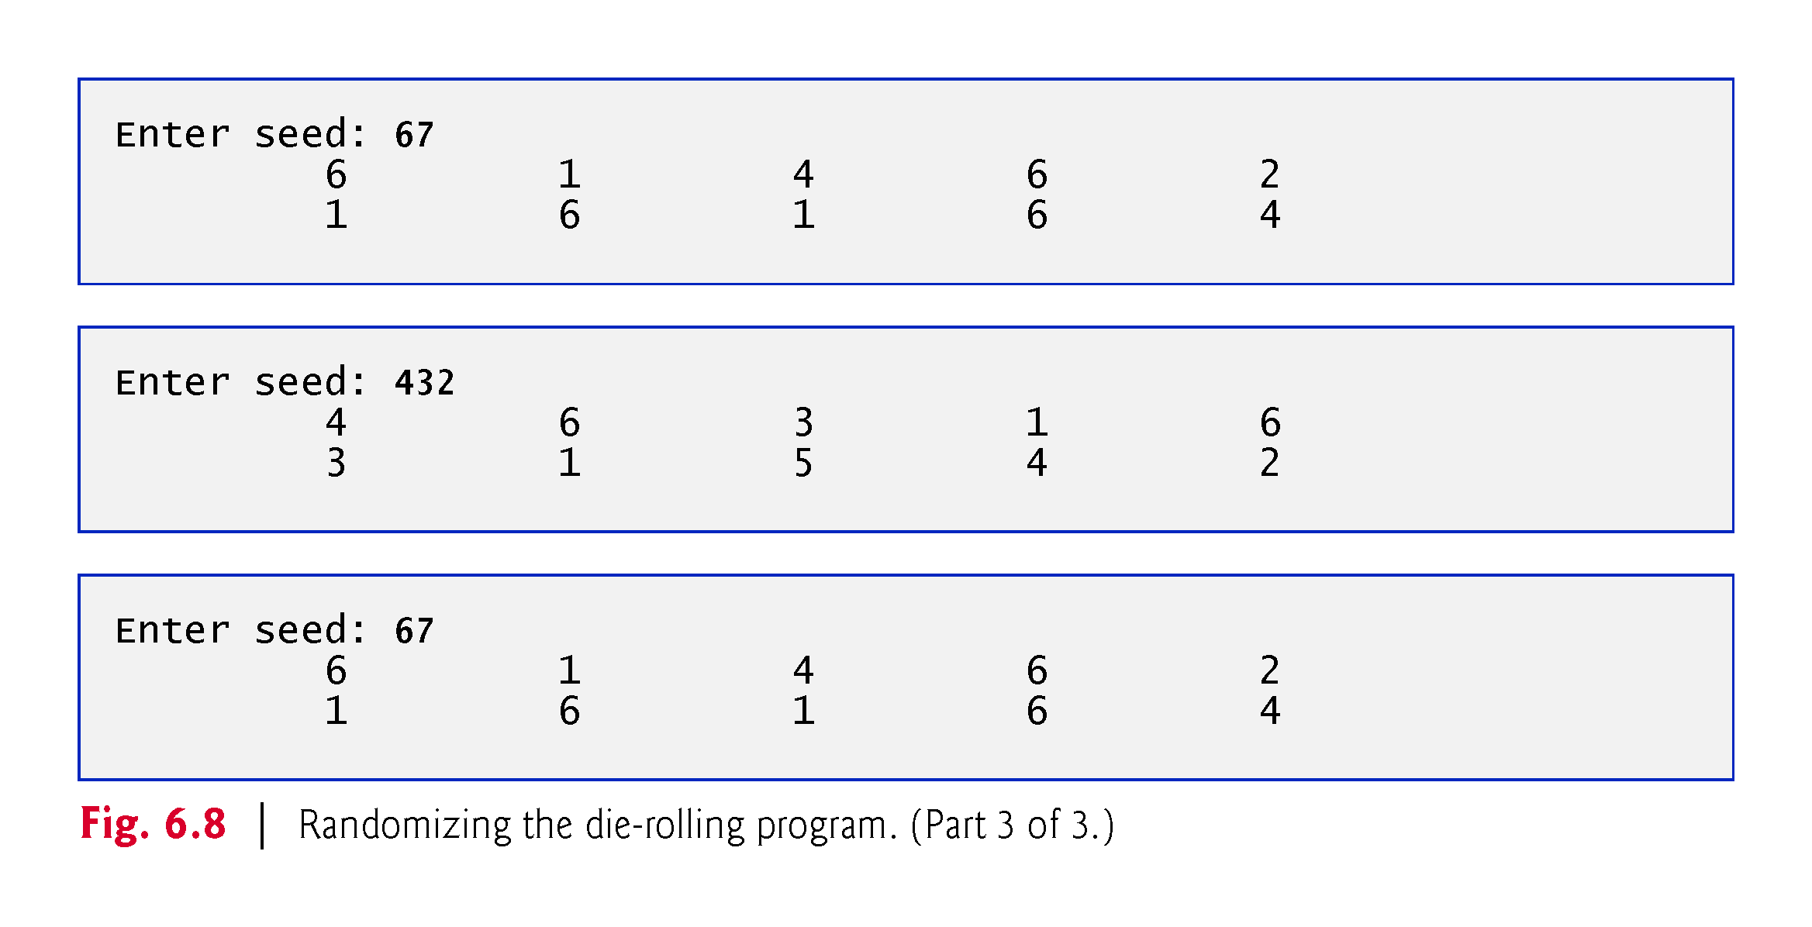
©1992-2017 by Pearson Education, Inc. All Rights Reserved.

Slide 33
6.7.4 Seeding the Random-Number Generator with the Current Time
To randomize without having to enter a seed
srand(static_cast<unsigned int>(time(0)));
Causes the computer to read its clock to obtain the value for the seed.
Function time (with the argument 0 as written in the preceding statement) returns the current time as the number of seconds since January 1, 1970, at midnight Greenwich Mean Time (GMT).
The function prototype for time is in <ctime>.
©1992-2017 by Pearson Education, Inc. All Rights Reserved.

Slide 34
6.7.5 Scaling and Shifting Random Numbers
To produce random numbers in a specific range use:
type variableName = shiftingValue + rand() % scalingFactor;
shiftingValue is equal to the first number in the desired range of consecutive integers
scalingFactor is equal to the width of the de-sired range of consecutive integers.
©1992-2017 by Pearson Education, Inc. All Rights Reserved.

Slide 35
6.8 Case Study: Game of Chance; Introducing enum
Rules of Craps
A player rolls two dice. Each die has six faces.
Faces contain 1, 2, 3, 4, 5 and 6 spots.
After the dice have come to rest, the sum of the spots on the two upward faces is calculated.
If the sum is 7 or 11 on the first roll, the player wins.
If the sum is 2, 3 or 12 on the first roll (called “craps”), the player loses (i.e., the “house” wins).
If the sum is 4, 5, 6, 8, 9 or 10 on the first roll, then that sum becomes the player’s “point.”
To win, continue rolling until you “make your point.”
You lose by rolling a 7 before making the point.
The program in Fig. 6.9 simulates the game.
©1992-2017 by Pearson Education, Inc. All Rights Reserved.

Slide 36
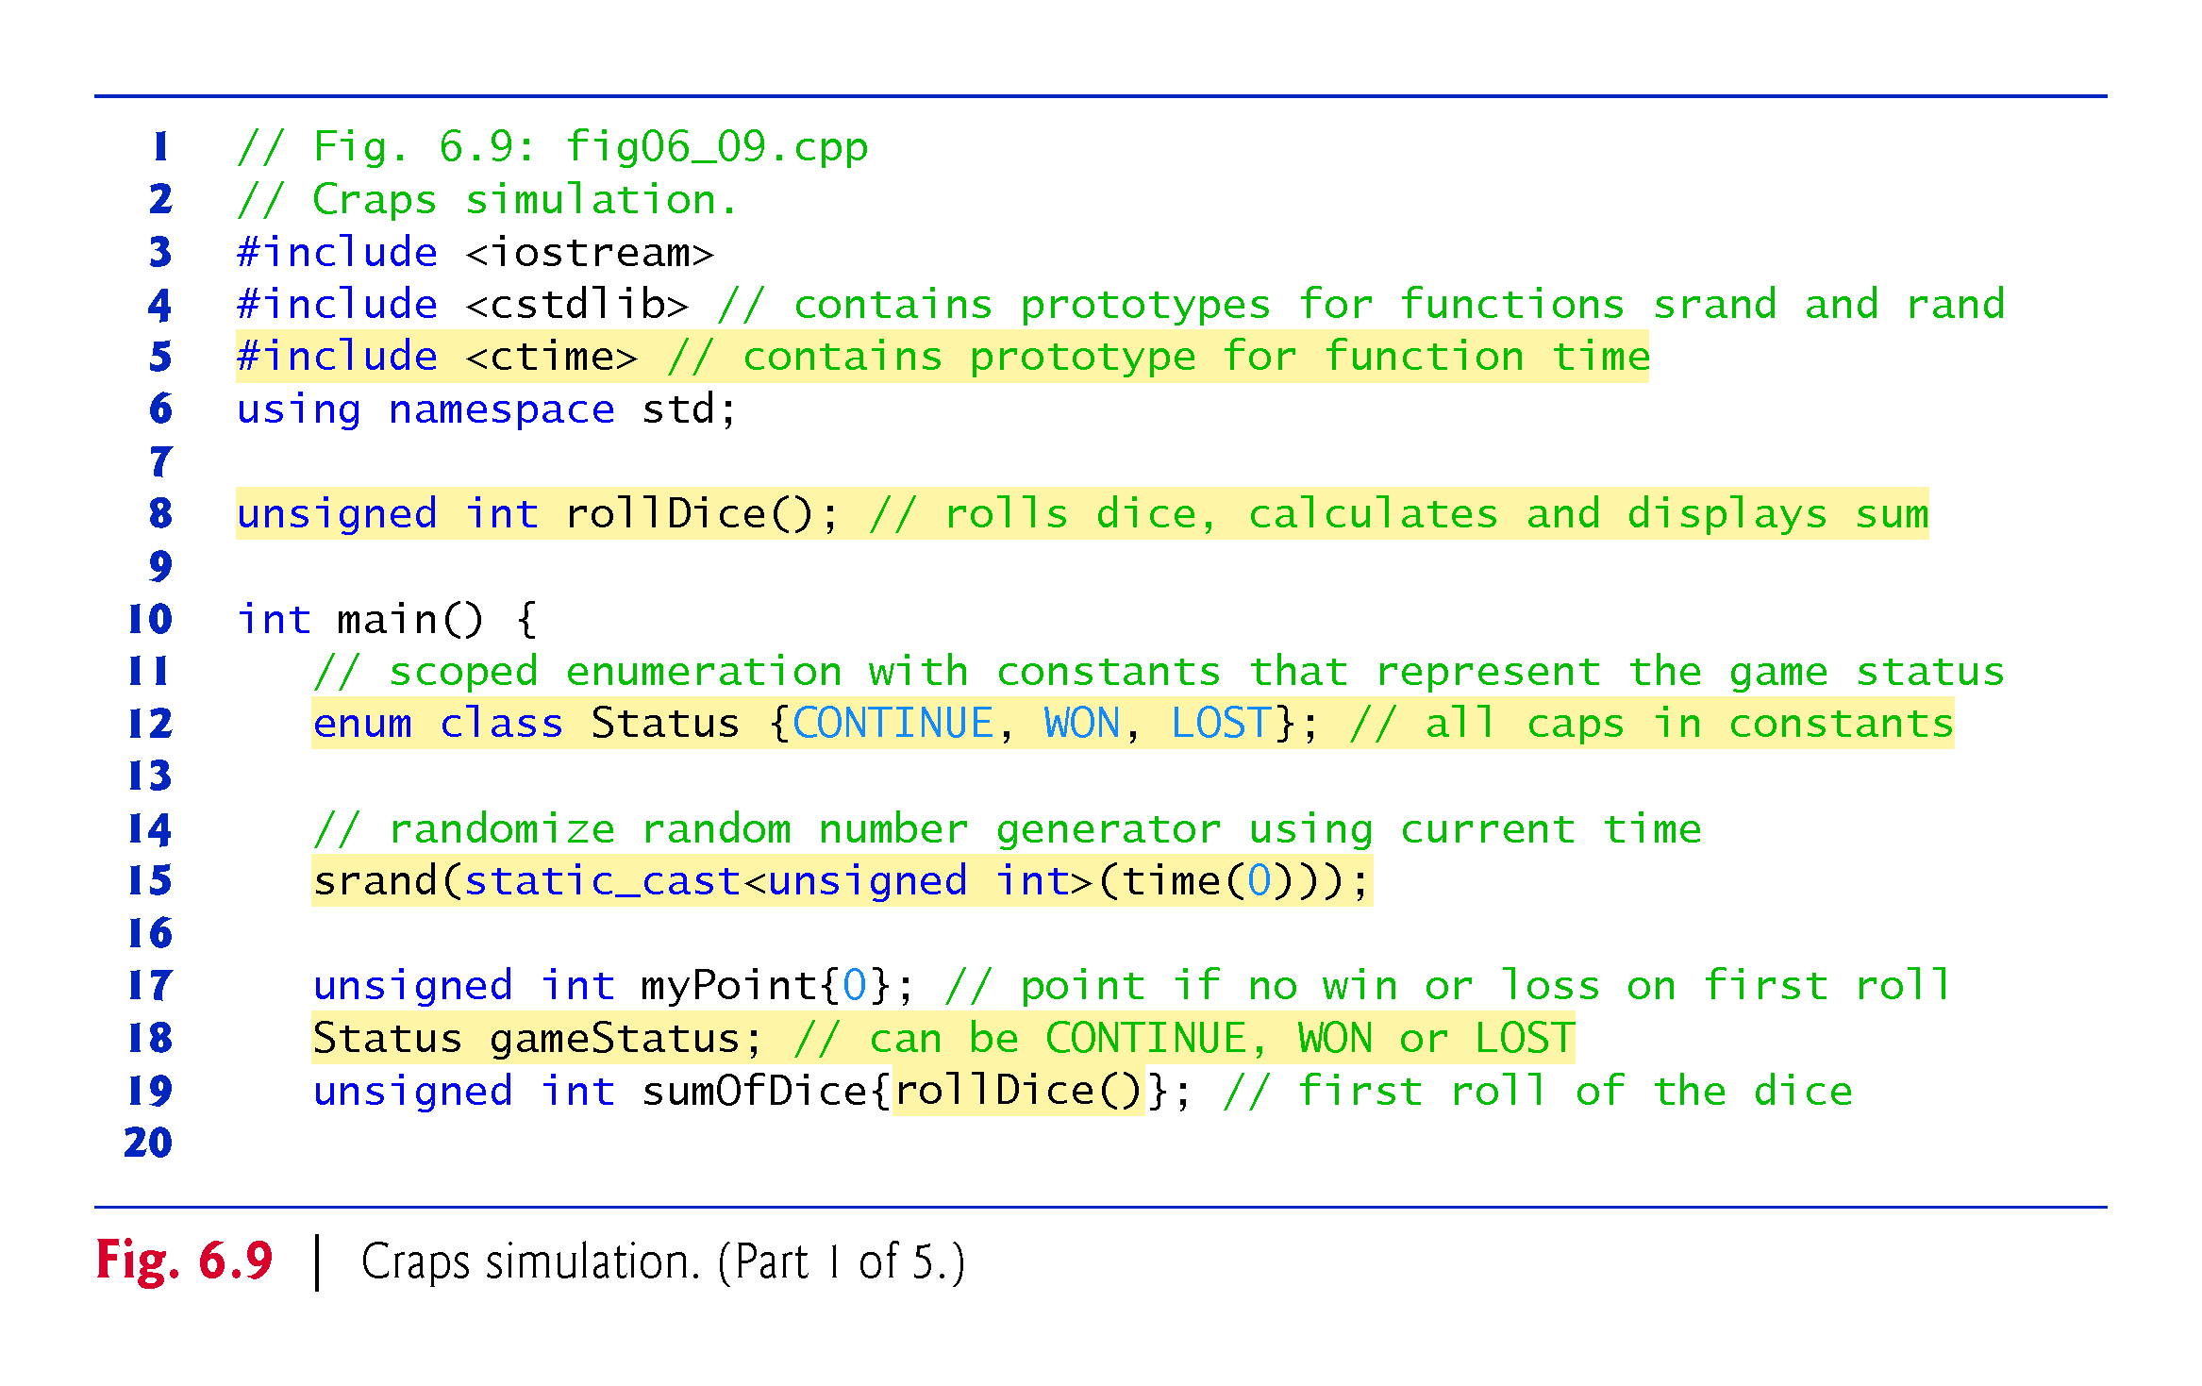
©1992-2017 by Pearson Education, Inc. All Rights Reserved.

Slide 37
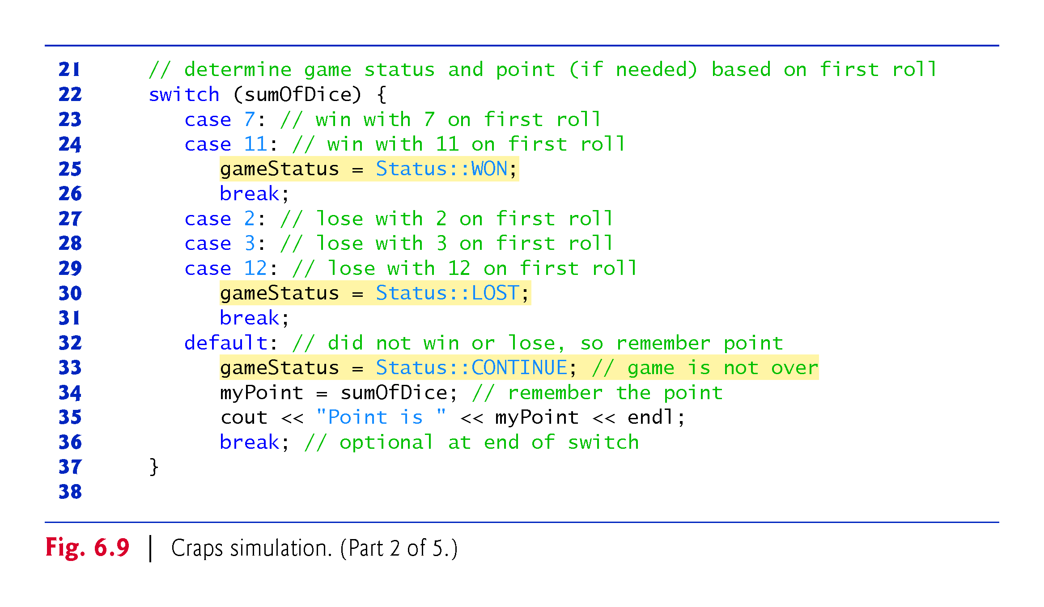
©1992-2017 by Pearson Education, Inc. All Rights Reserved.

Slide 38
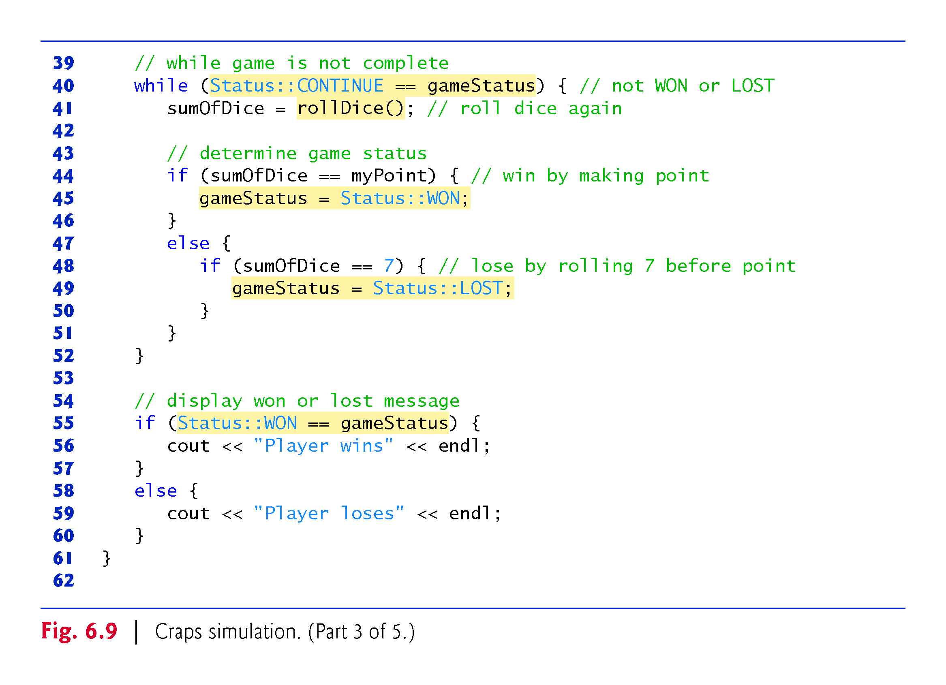
©1992-2017 by Pearson Education, Inc. All Rights Reserved.

Slide 39
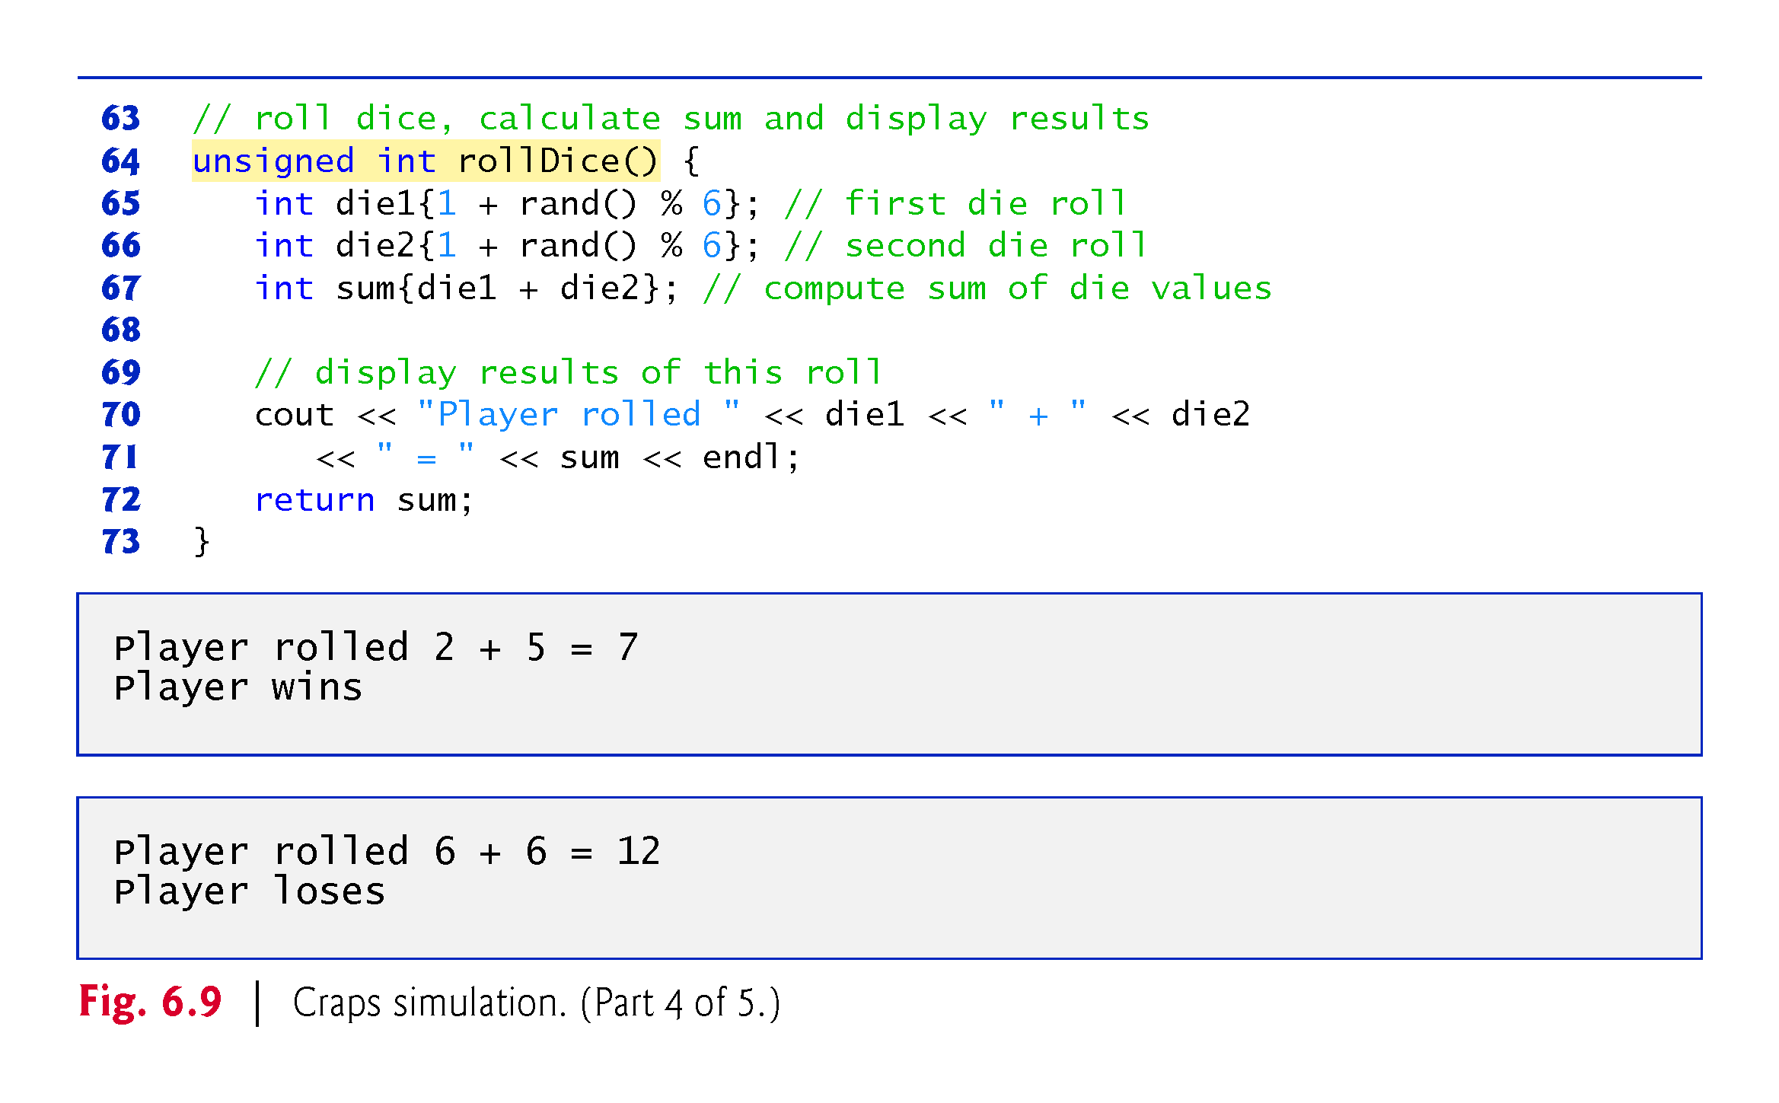
©1992-2017 by Pearson Education, Inc. All Rights Reserved.

Slide 40
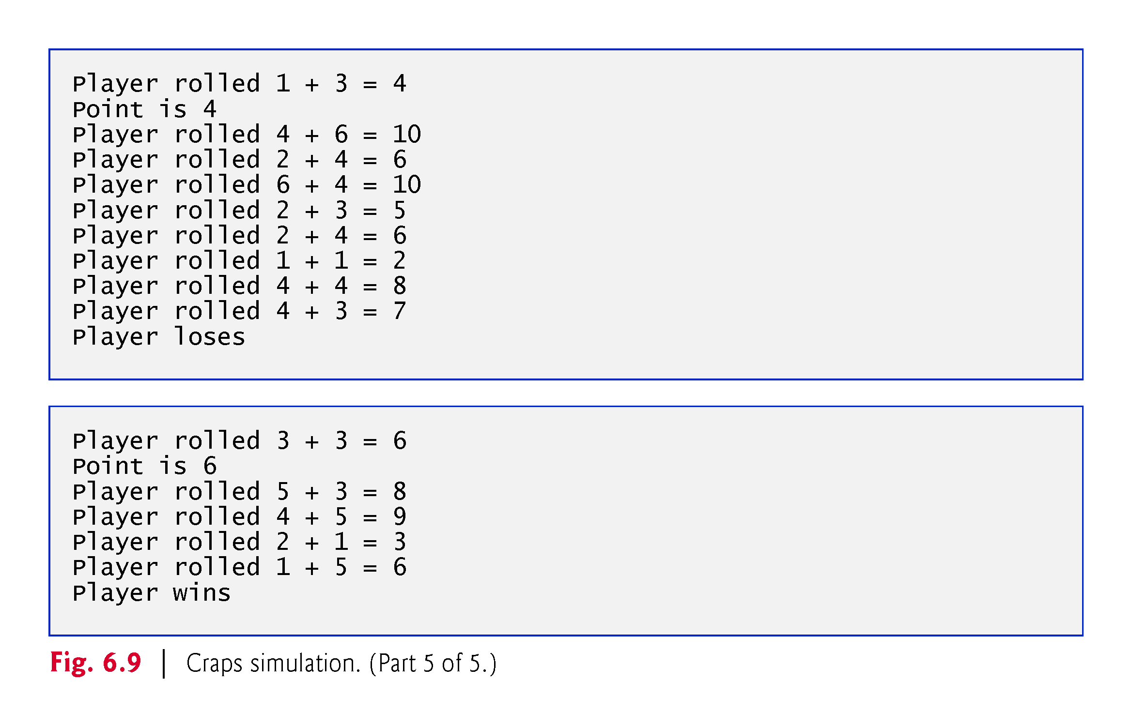
©1992-2017 by Pearson Education, Inc. All Rights Reserved.

Slide 41
6.8 Case Study: Game of Chance; Introducing enum (cont.)
A scoped enumeration (C++11) introduced by enum class and followed by a type name, is a set of identifiers representing integer constants.
The values of these enumeration constants start at 0, unless specified otherwise, and increment by 1.
The identifiers must be unique, but separate enumeration constants can have the same value.
Variables of an enum class can be assigned only one of the values declared in the enumeration.
©1992-2017 by Pearson Education, Inc. All Rights Reserved.

Slide 42
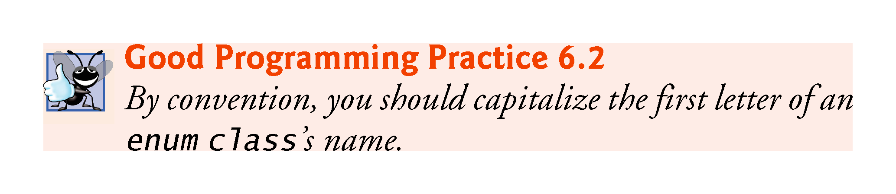
©1992-2017 by Pearson Education, Inc. All Rights Reserved.

Slide 43
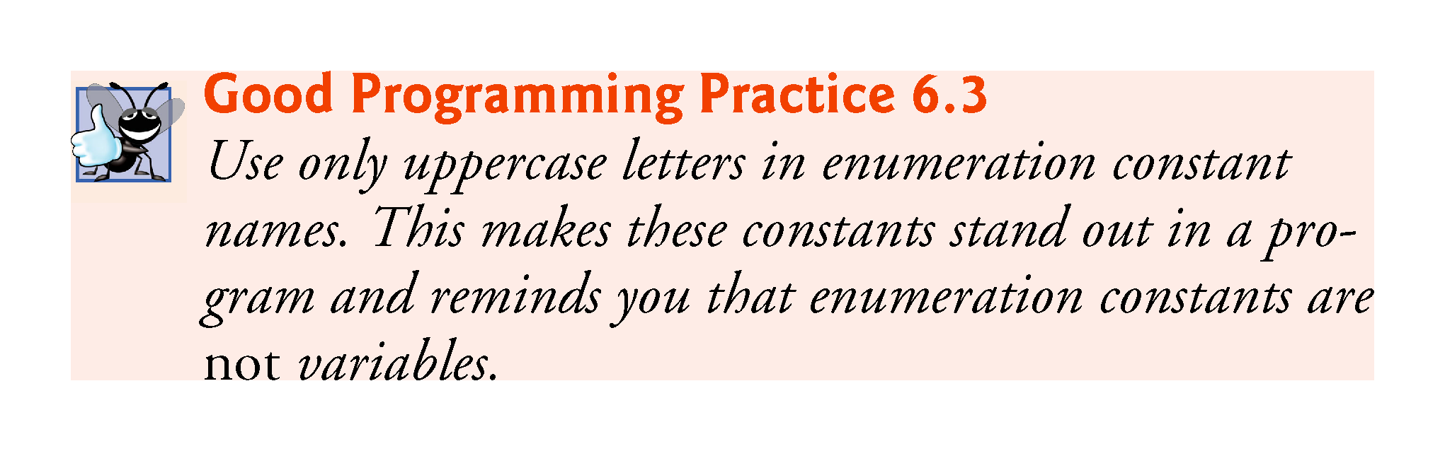
©1992-2017 by Pearson Education, Inc. All Rights Reserved.

Slide 44
6.8 Case Study: Game of Chance; Introducing enum (cont.)
To reference a scoped enum constant, qualify it with the type name and the scope-resolution operator (::), as in Status::CONTINUE.
©1992-2017 by Pearson Education, Inc. All Rights Reserved.

Slide 45
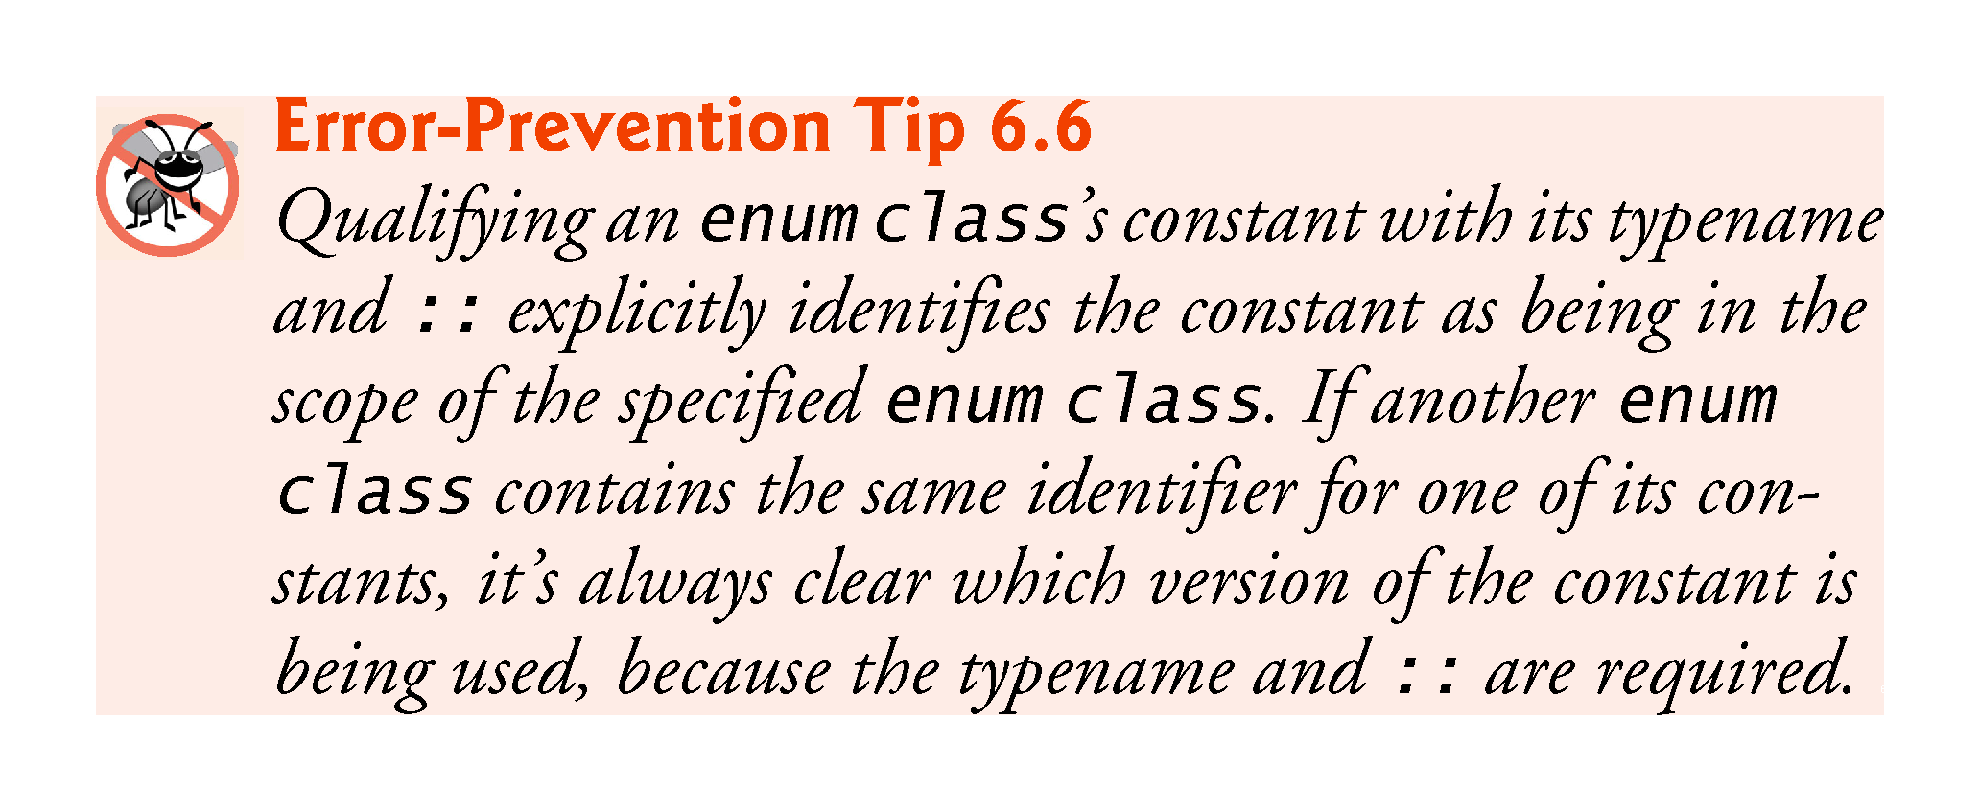
©1992-2017 by Pearson Education, Inc. All Rights Reserved.

Slide 46
6.8 Case Study: Game of Chance; Introducing enum (cont.)
Another popular enumeration is
enum class Months { JAN = 1, FEB, MAR, APR, MAY, JUN, JUL, AUG, SEP, OCT, NOV, DEC };
creates user-defined type Months with enumeration constants representing the months of the year.
The first value in the preceding enumeration is explicitly set to 1, so the remaining values increment from 1, resulting in the values 1 through 12.
Any enumeration constant can be assigned an integer value in the enumeration definition.
©1992-2017 by Pearson Education, Inc. All Rights Reserved.

Slide 47
Exercise
Write a program that asks for an integer “seed” and prints 20 random integers with that seed. Use srand(seed) and rand() to generate the numbers. Try with different values of seed.
Modify the program so that the values are between 0 and 9.
Modify the program so that the values are between 5 and 10.
©1992-2017 by Pearson Education, Inc. All Rights Reserved.

Slide 48
6.12 Inline Functions
C++ provides inline functions to help reduce function call overhead.
Placing the qualifier inline before a function’s return type in the function definition advises the compiler to generate a copy of the function’s code in every place where the function is called (when appropriate) to avoid a function call.
This often makes the program larger.
Reusable inline functions are typically placed in headers, so that their definitions can be included in each source file that uses them.
©1992-2017 by Pearson Education, Inc. All Rights Reserved.

Slide 49
6.12 Inline Functions
Figure 6.16 uses inline function cube (lines 9–11) to calculate the volume of a cube.
Keyword const in function cube’s parameter list (line 9) tells the compiler that the function does not modify variable side.
This ensures that side’s value is not changed by the function during the calculation.
©1992-2017 by Pearson Education, Inc. All Rights Reserved.

Slide 50
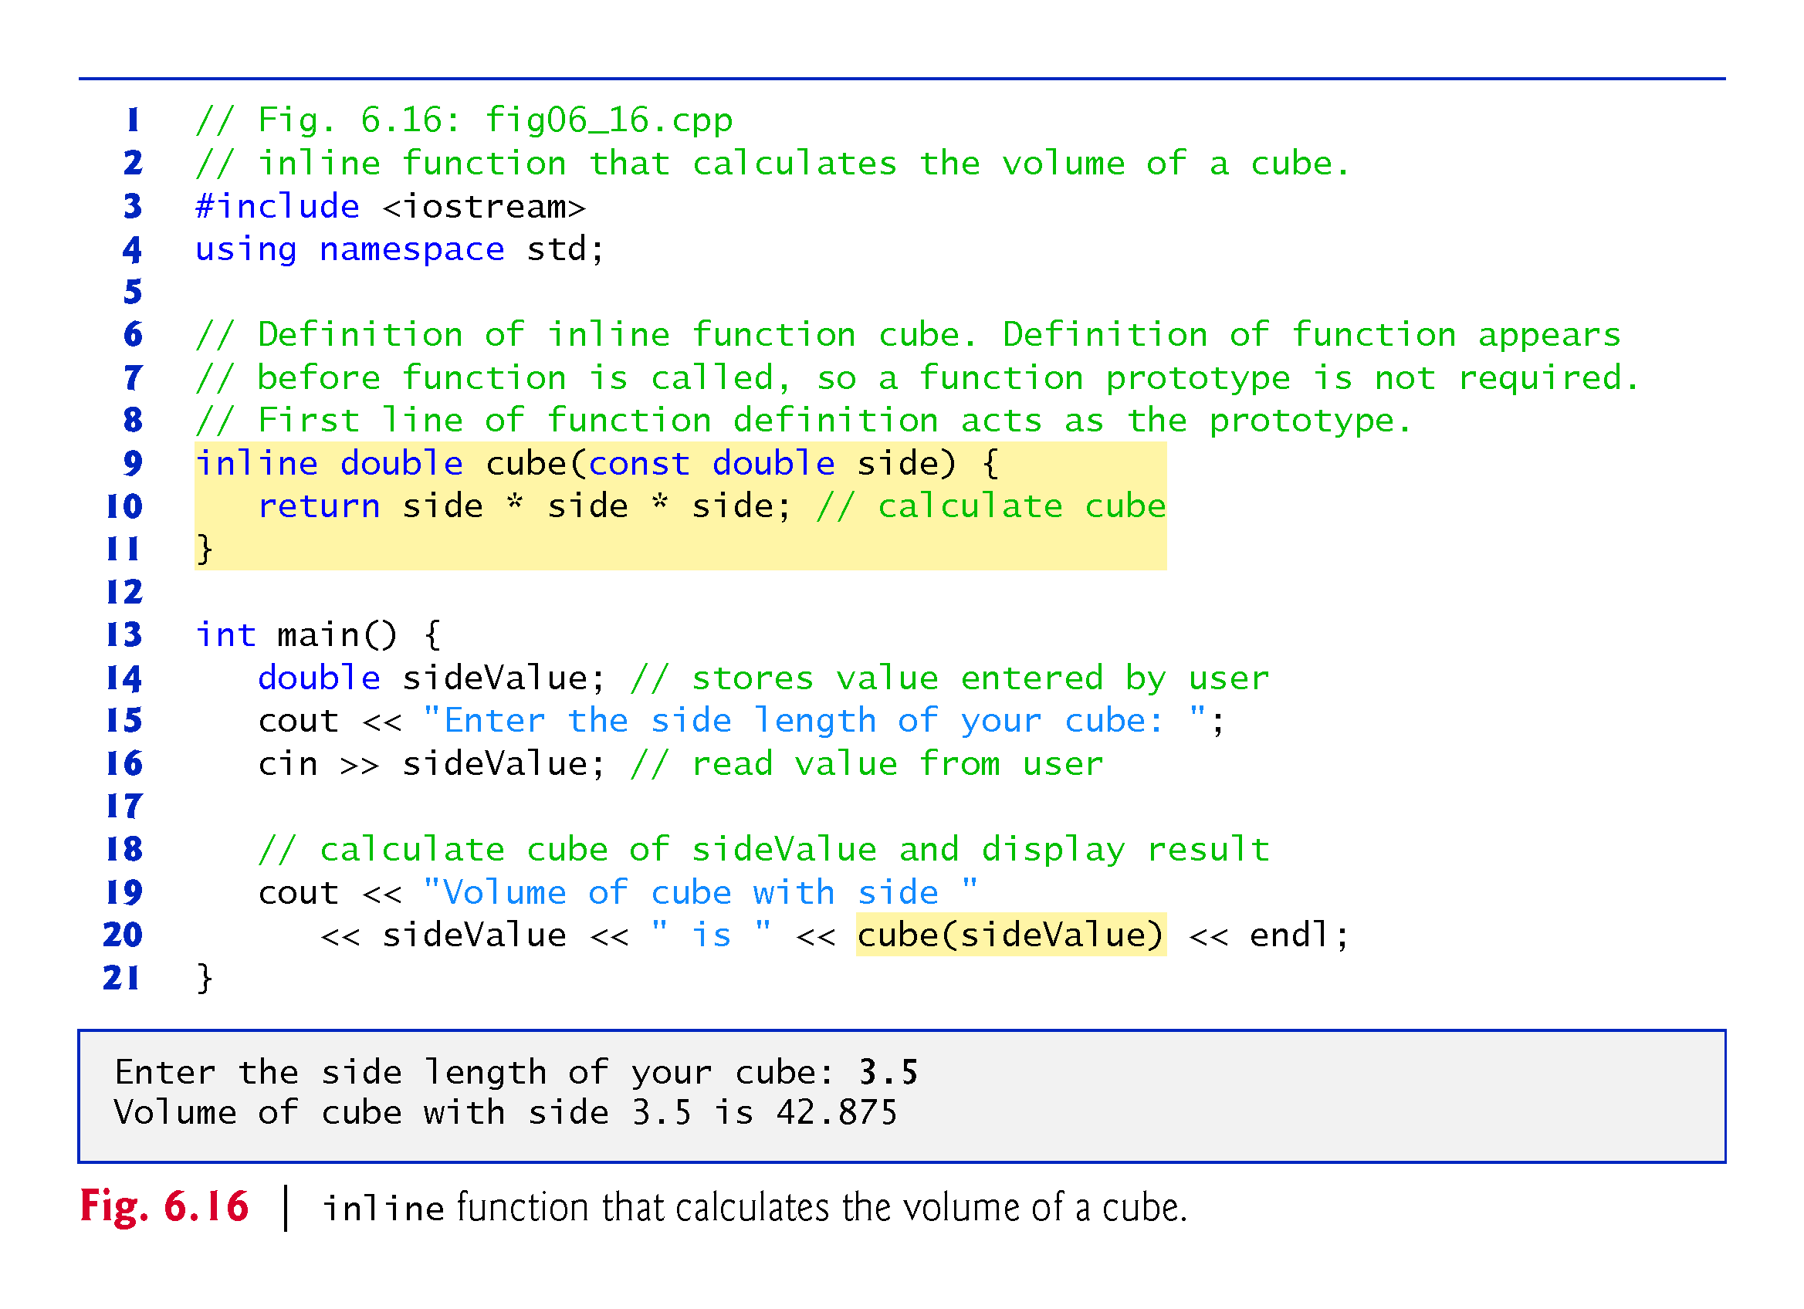
©1992-2017 by Pearson Education, Inc. All Rights Reserved.

Slide 51
6.13 References and Reference Parameters
Two ways to pass arguments to functions in many programming languages are pass-by-value and pass-by-reference.
When an argument is passed by value, a copy of the argument’s value is made and passed (on the function call stack) to the called function.
Changes to the copy do not affect the original variable’s value in the caller.
To specify a reference to a constant, place the const qualifier before the type specifier in the parameter declaration.
©1992-2017 by Pearson Education, Inc. All Rights Reserved.

Slide 52
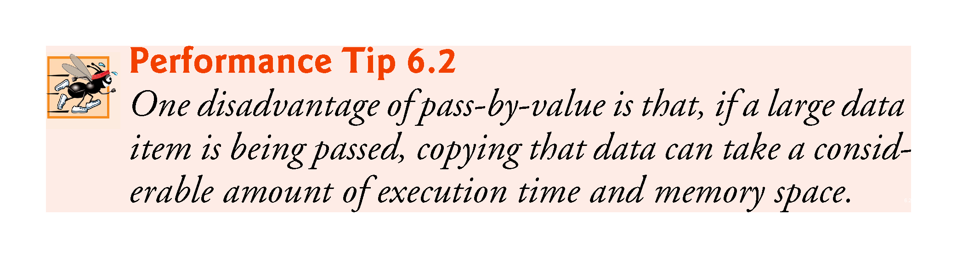
©1992-2017 by Pearson Education, Inc. All Rights Reserved.

Slide 53
6.13 References and Reference Parameters (cont.)
With pass-by-reference, the caller gives the called function the ability to access the caller’s data directly, and to modify that data.
A reference parameter is an alias for its corresponding argument in a function call.
To indicate that a function parameter is passed by reference, simply follow the parameter’s type in the function prototype by an ampersand (&); use the same convention when listing the parameter’s type in the function header.
Figure 6.17 compares pass-by-value and pass-by-reference with reference parameters.
©1992-2017 by Pearson Education, Inc. All Rights Reserved.

Slide 54
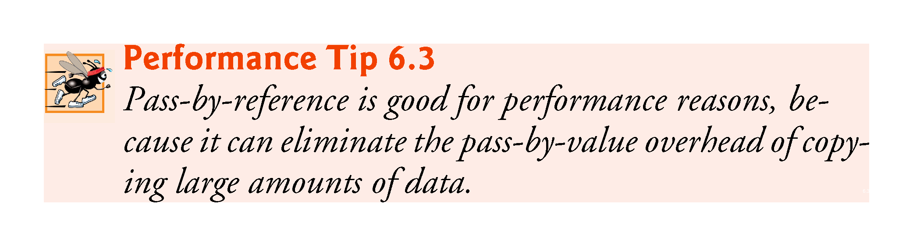
©1992-2017 by Pearson Education, Inc. All Rights Reserved.

Slide 55
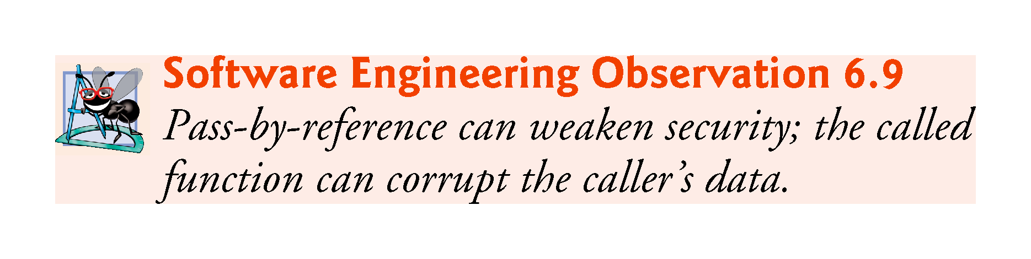
©1992-2017 by Pearson Education, Inc. All Rights Reserved.

Slide 56
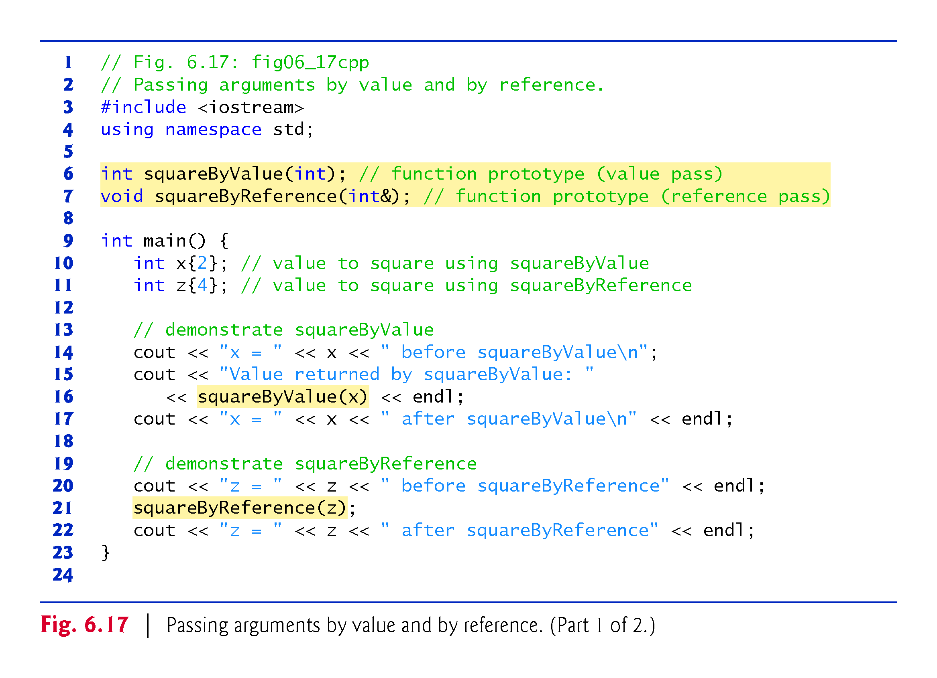
©1992-2017 by Pearson Education, Inc. All Rights Reserved.

Slide 57
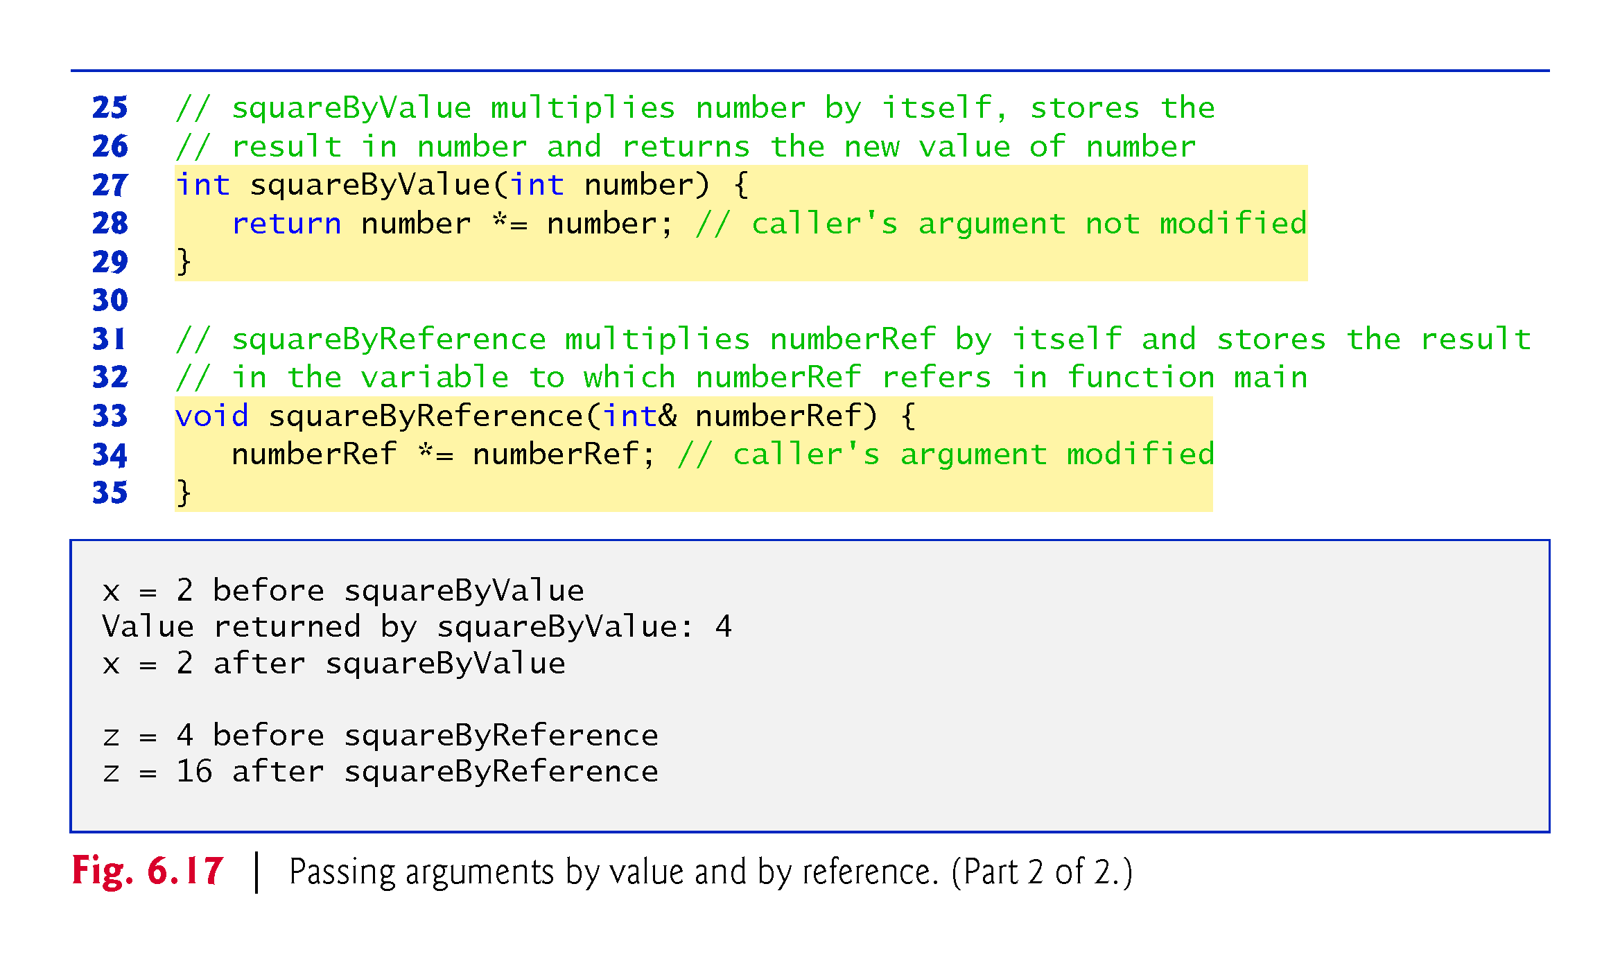
©1992-2017 by Pearson Education, Inc. All Rights Reserved.

Slide 58
6.14 Default Arguments
It common for a program to invoke a function repeatedly with the same argument value for a particular parameter.
Can specify that such a parameter has a default argument, i.e., a default value to be passed to that parameter.
When a program omits an argument for a parameter with a default argument in a function call, the compiler rewrites the function call and inserts the default value of that argument.
Figure 6.18 demonstrates using default arguments to calculate a box’s volume.
©1992-2017 by Pearson Education, Inc. All Rights Reserved.

Slide 59
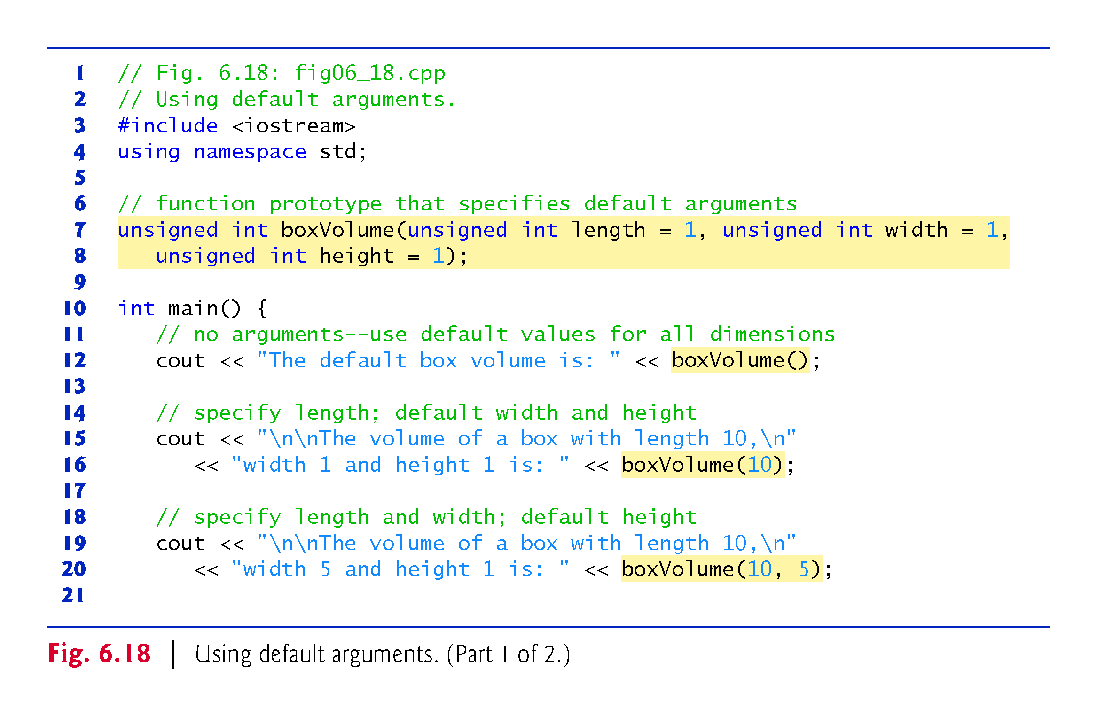
©1992-2017 by Pearson Education, Inc. All Rights Reserved.

Slide 60
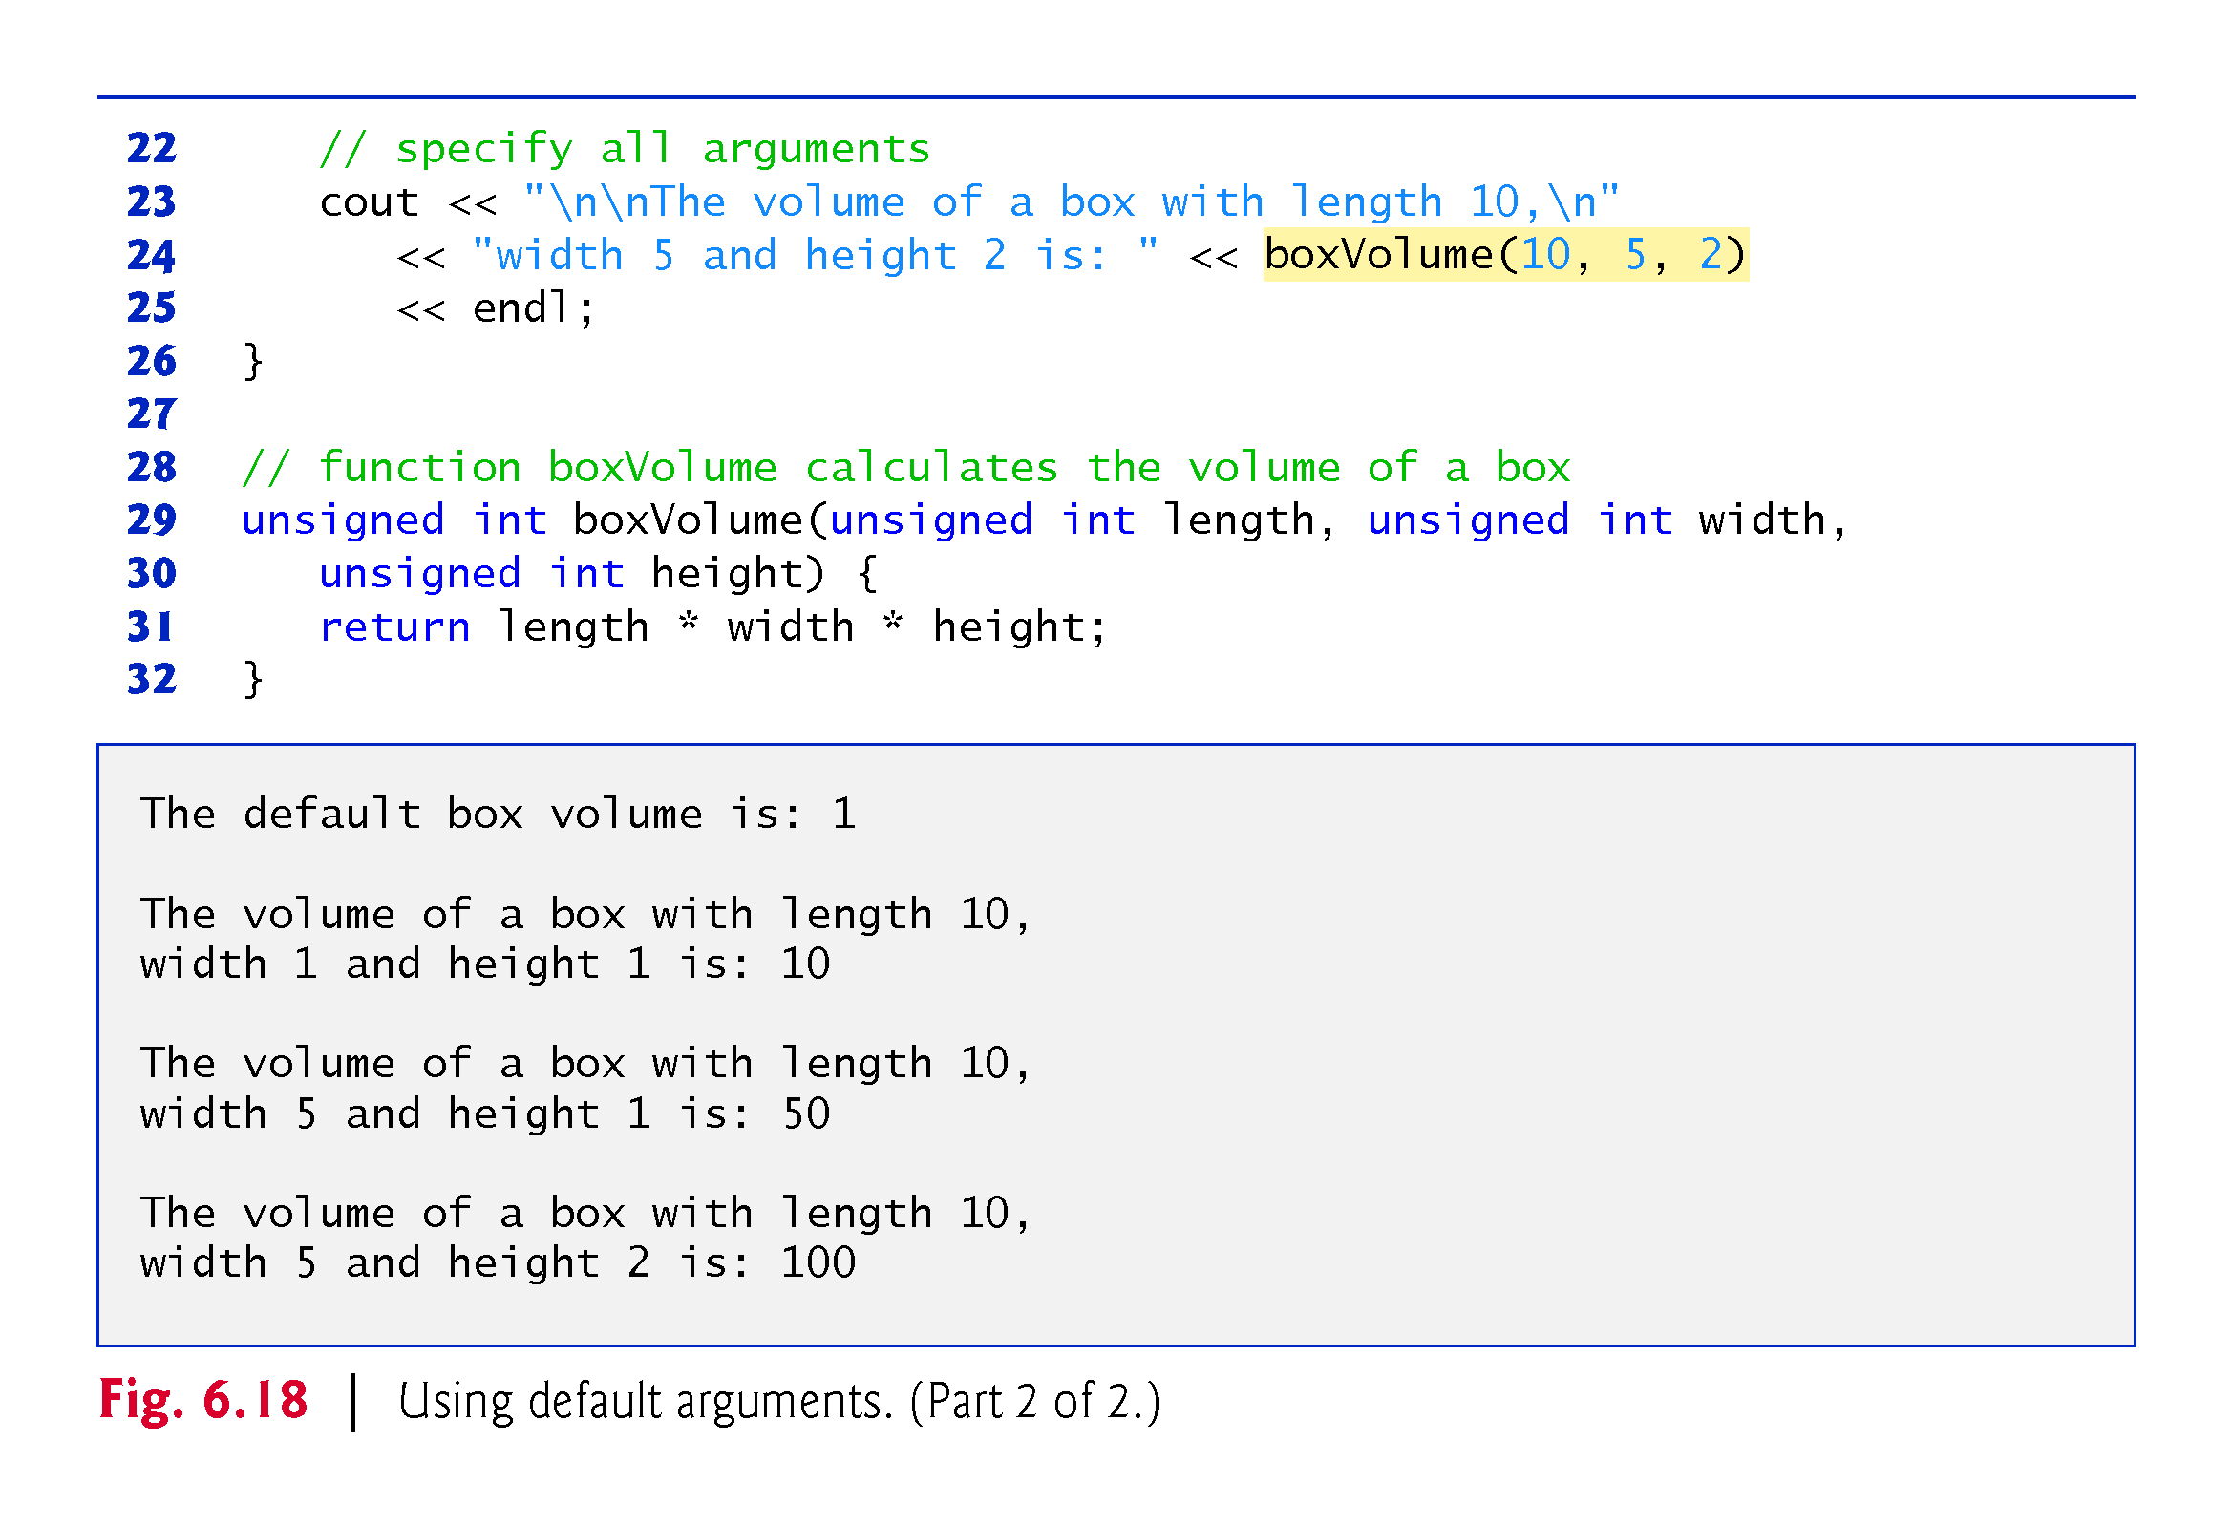
©1992-2017 by Pearson Education, Inc. All Rights Reserved.

Slide 61
6.14 Default Arguments
Default arguments must be the rightmost (trailing) arguments in a function’s parameter list.
When calling a function with two or more default arguments, if an omitted argument is not the rightmost argument, then all arguments to the right of that argument also must be omitted.
Default arguments must be specified with the first occurrence of the function name—typically, in the function prototype.
Default values can be any expression, including constants, global variables or function calls. Default arguments also can be used with inline functions.
©1992-2017 by Pearson Education, Inc. All Rights Reserved.

Slide 62
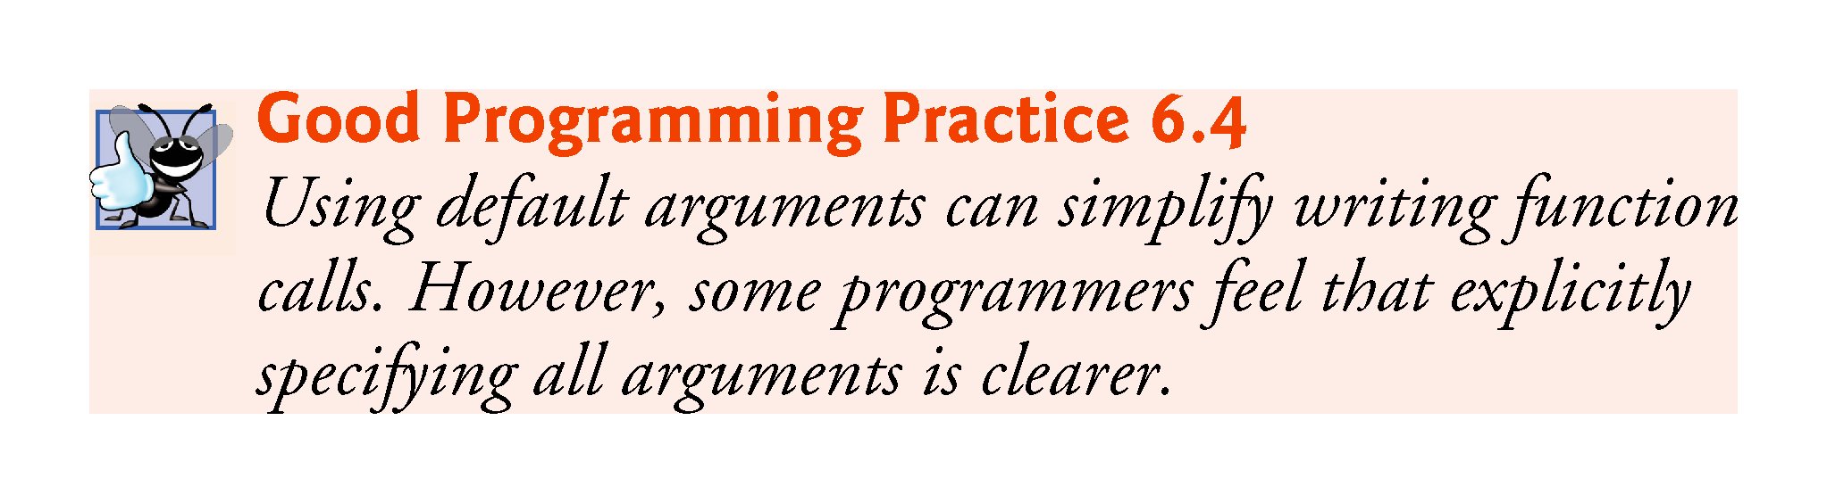
©1992-2017 by Pearson Education, Inc. All Rights Reserved.

Slide 63
6.15 Unary Scope Resolution Operator
C++ provides the unary scope resolution operator (::) to access a global variable when a local variable of the same name is in scope.
Using the unary scope resolution operator (::) with a given variable name is optional when the only variable with that name is a global variable.
Figure 6.19 shows the unary scope resolution operator with local and global variables of the same name.
©1992-2017 by Pearson Education, Inc. All Rights Reserved.

Slide 64
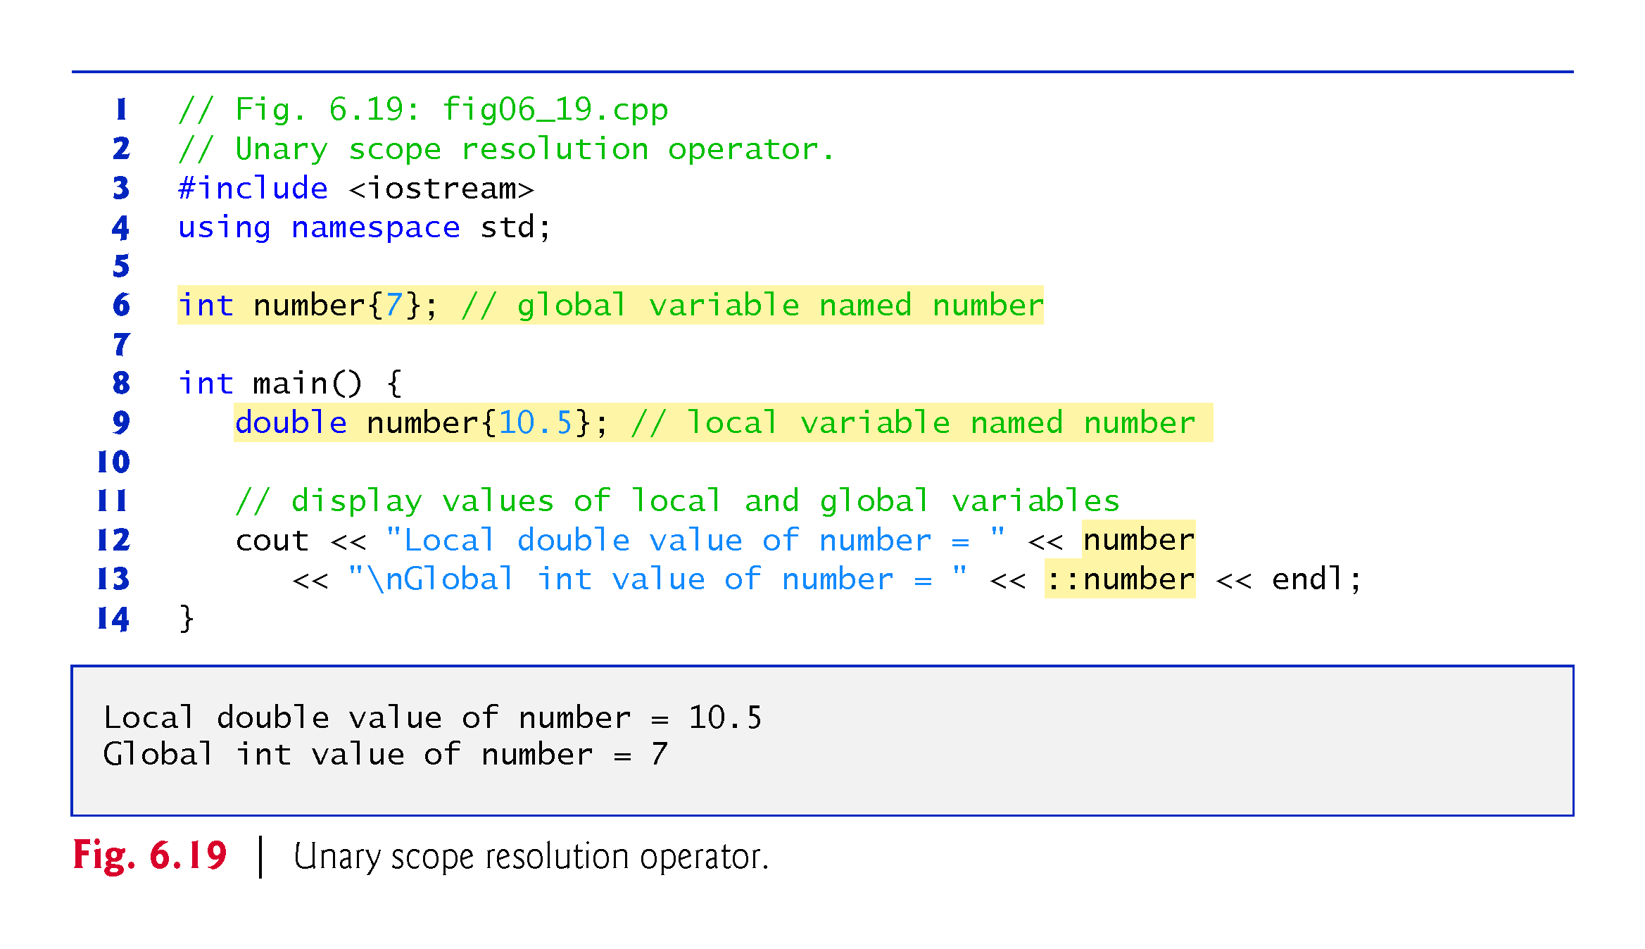
©1992-2017 by Pearson Education, Inc. All Rights Reserved.

Slide 65
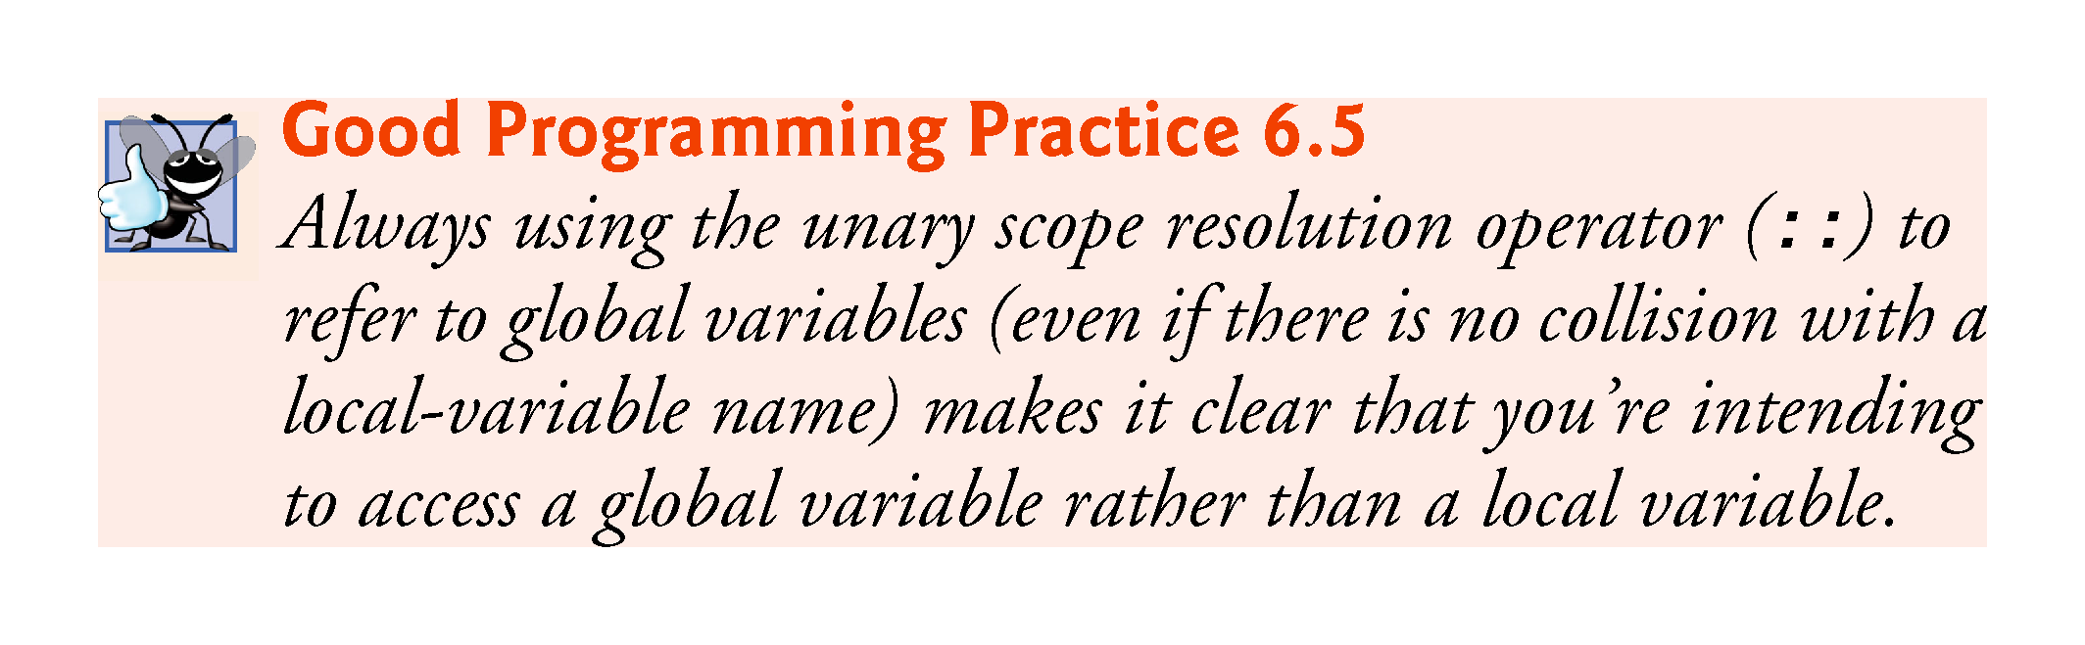
©1992-2017 by Pearson Education, Inc. All Rights Reserved.

Slide 66
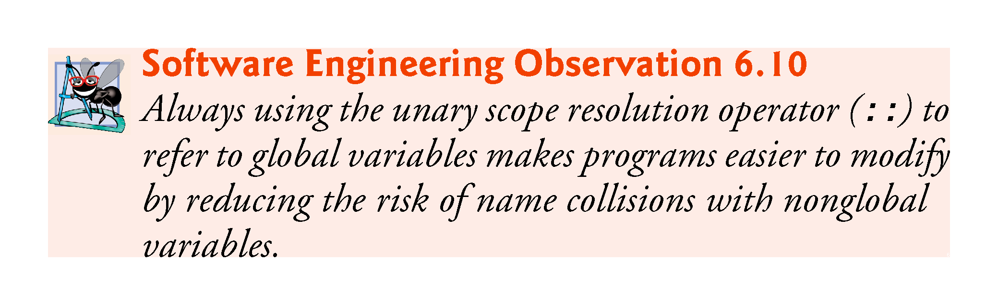
©1992-2017 by Pearson Education, Inc. All Rights Reserved.

Slide 67
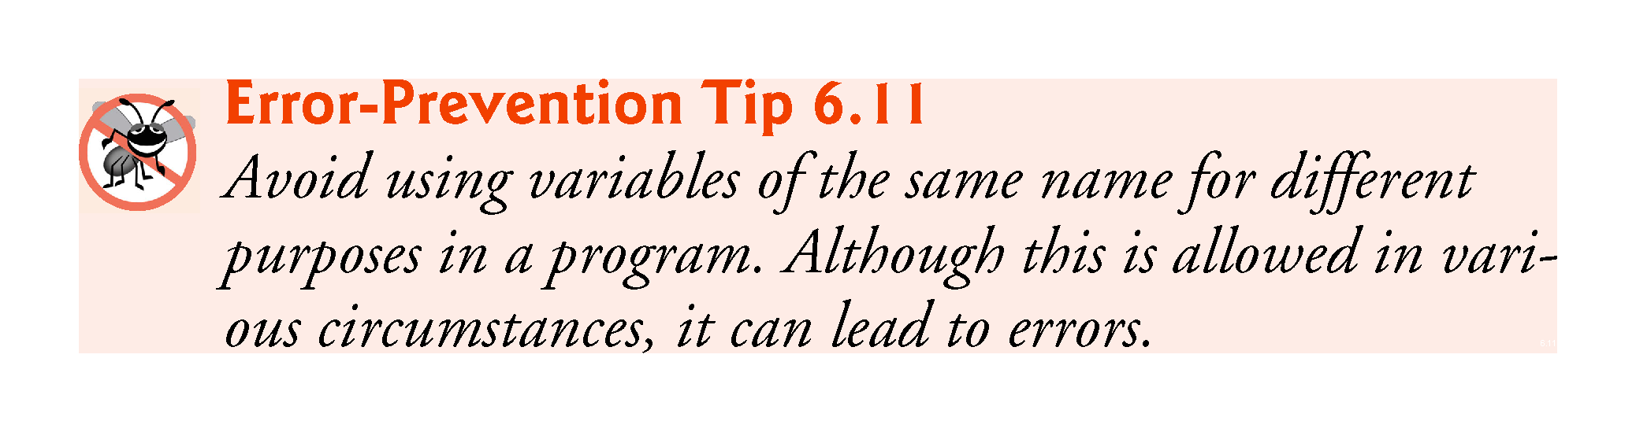
©1992-2017 by Pearson Education, Inc. All Rights Reserved.

Slide 68
6.16 Function Overloading
C++ enables several functions of the same name to be defined, as long as they have different signatures.
This is called function overloading.
The C++ compiler selects the proper function to call by examining the number, types and order of the arguments in the call.
Function overloading is used to create several functions of the same name that perform similar tasks, but on different data types.
©1992-2017 by Pearson Education, Inc. All Rights Reserved.

Slide 69
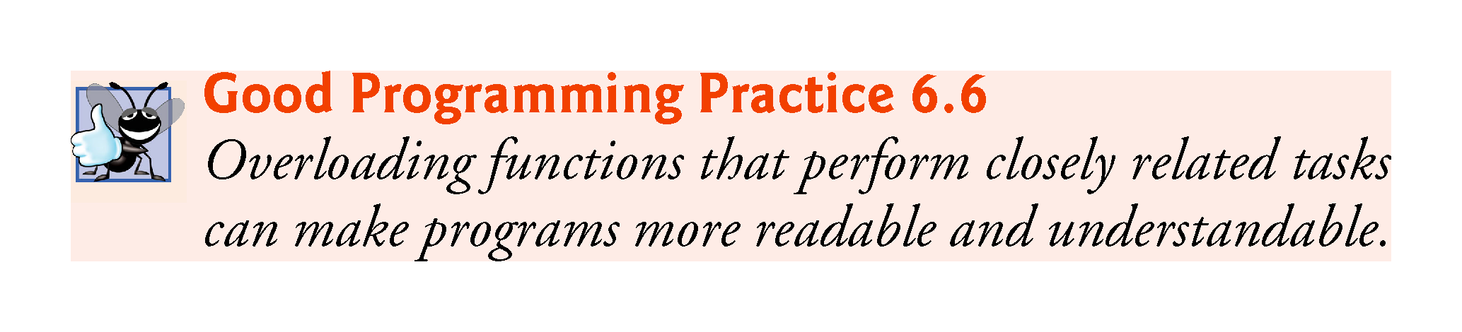
©1992-2017 by Pearson Education, Inc. All Rights Reserved.

Slide 70
6.16 Function Overloading (cont.)
Figure 6.20 uses overloaded square functions to calculate the square of an int and the square of a double.
©1992-2017 by Pearson Education, Inc. All Rights Reserved.

Slide 71
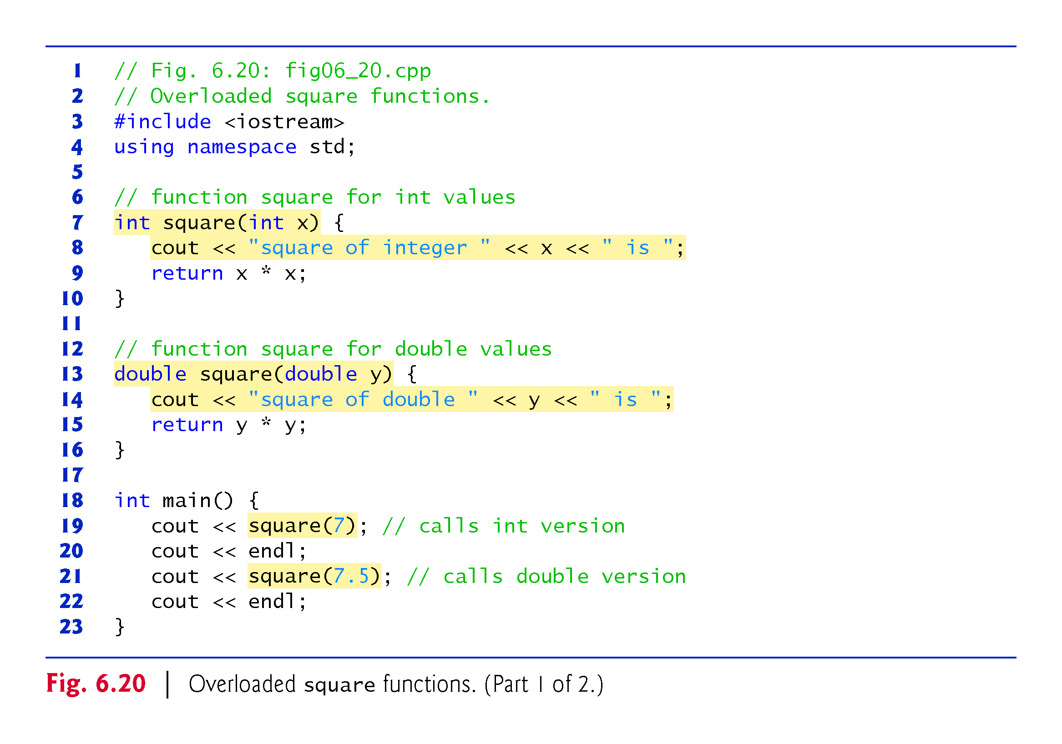
©1992-2017 by Pearson Education, Inc. All Rights Reserved.

Slide 72
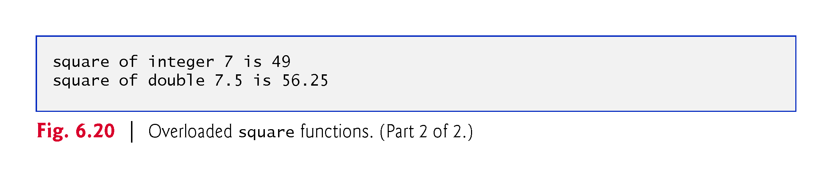
©1992-2017 by Pearson Education, Inc. All Rights Reserved.

Slide 73
6.16 Function Overloading (cont.)
How the Compiler Differentiates Among Overloaded Functions
Overloaded functions are distinguished by their signatures.
A signature is a combination of a function’s name and its parameter types (in order).
The compiler encodes each function identifier with the types of its parameters (sometimes referred to as name mangling or name decoration) to enable type-safe linkage.
Ensures that the proper overloaded function is called and that the types of the arguments conform to the types of the parameters.
Figure 6.21 was compiled with GNU C++.
Rather than showing the execution output of the program, we show the mangled function names produced in assembly language by GNU C++.
©1992-2017 by Pearson Education, Inc. All Rights Reserved.

Slide 74
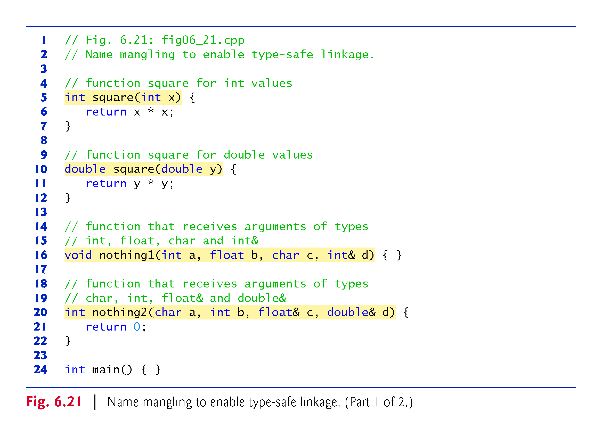
©1992-2017 by Pearson Education, Inc. All Rights Reserved.

Slide 75
6.17 Function Templates
If the program logic and operations are identical for each data type, overloading may be performed more compactly and conveniently by using function templates.
You write a single function template definition.
Given the argument types provided in calls to this function, C++ automatically generates separate function template specializations to handle each type of call appropriately.
©1992-2017 by Pearson Education, Inc. All Rights Reserved.

Slide 76
6.17 Function Templates (cont.)
Figure 6.22 defines a maximum function that determines the largest of three values.
All function template definitions begin with the template keyword followed by a template parameter list enclosed in angle brackets (< and >).
Every parameter in the template parameter list is preceded by keyword typename or keyword class.
The type parameters are placeholders for fundamental types or user-defined types.
Used to specify the types of the function’s parameters, to specify the function’s return type and to declare variables within the body of the function definition.
©1992-2017 by Pearson Education, Inc. All Rights Reserved.

Slide 77
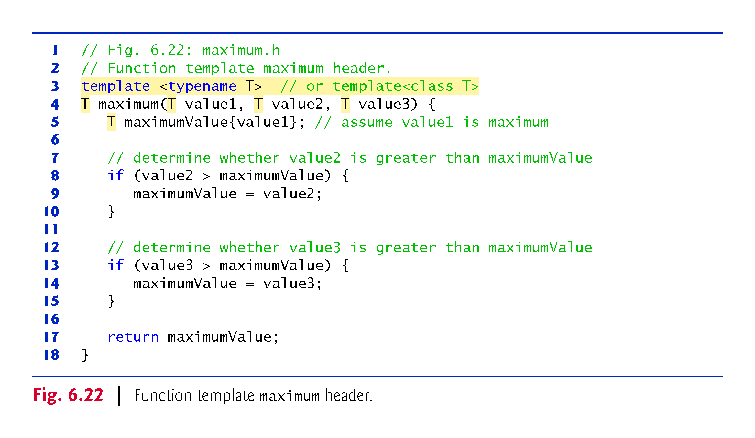
©1992-2017 by Pearson Education, Inc. All Rights Reserved.

Slide 78
6.19 Function Templates (cont.)
Figure 6.23 uses the maximum function template to determine the largest of three int values, three double values and three char values, respectively.
Separate functions are created as a result of the calls—expecting three int values, three double values and three char values, respectively.
©1992-2017 by Pearson Education, Inc. All Rights Reserved.

Slide 79
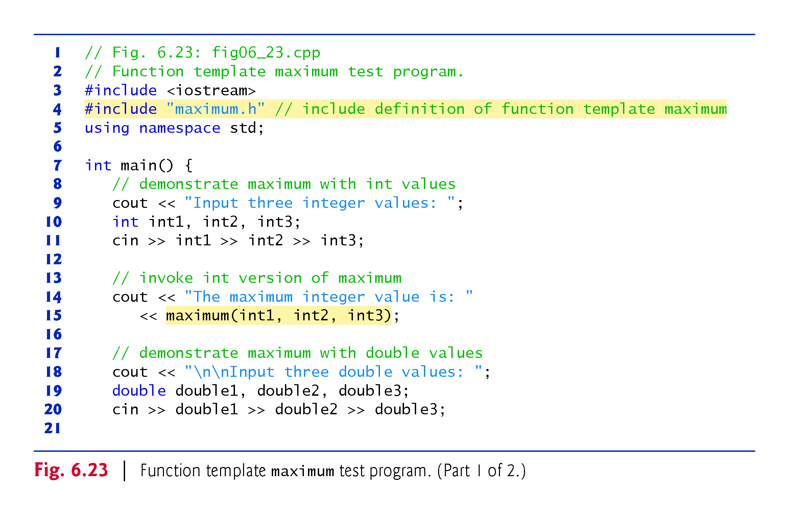
©1992-2017 by Pearson Education, Inc. All Rights Reserved.

Slide 80
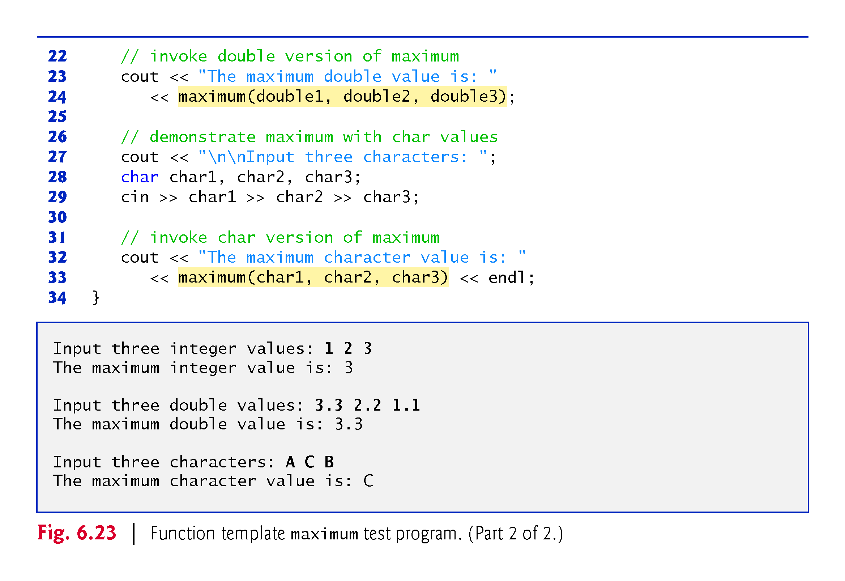
©1992-2017 by Pearson Education, Inc. All Rights Reserved.

